Slide 1
Artificial Neural Network
LECTURE #2
1-23-2020 SCROLL ON FOR LECTURE 3, LECTURE 4, ETC...

Slide 2
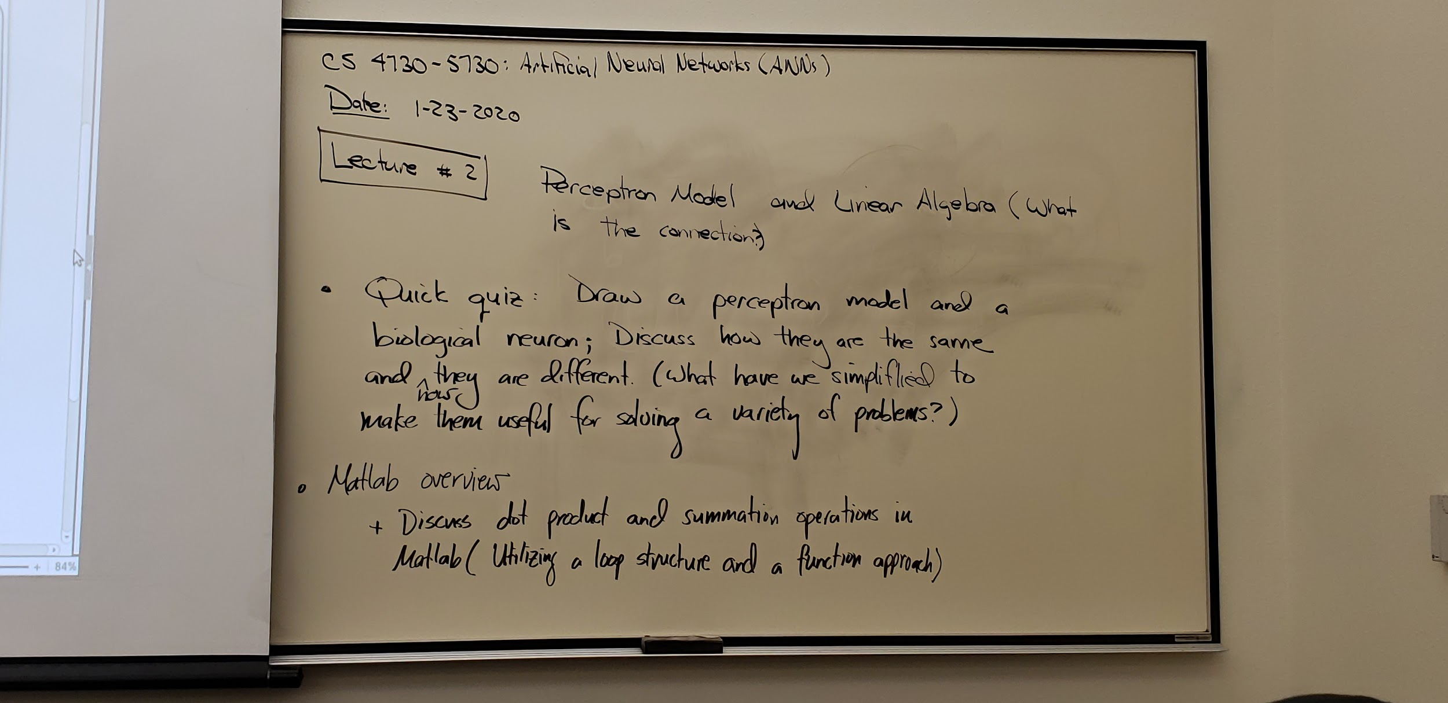

Slide 3
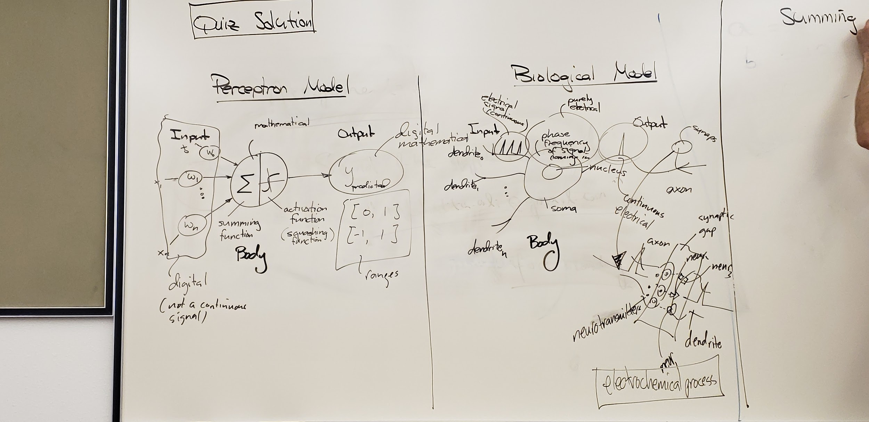

Slide 4
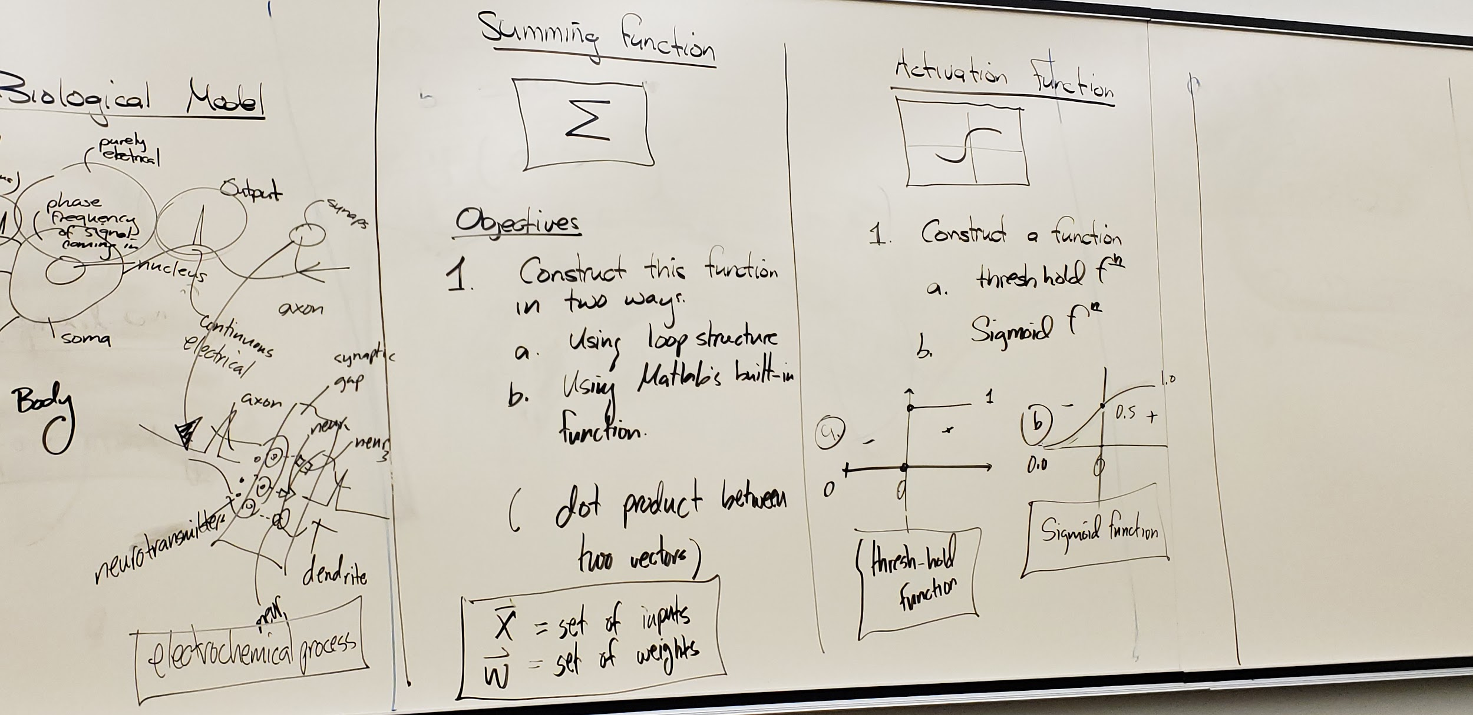

Slide 5
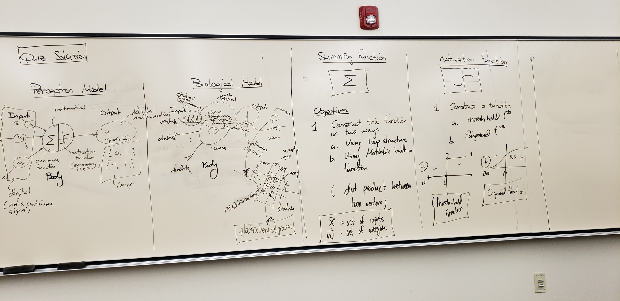

Slide 6
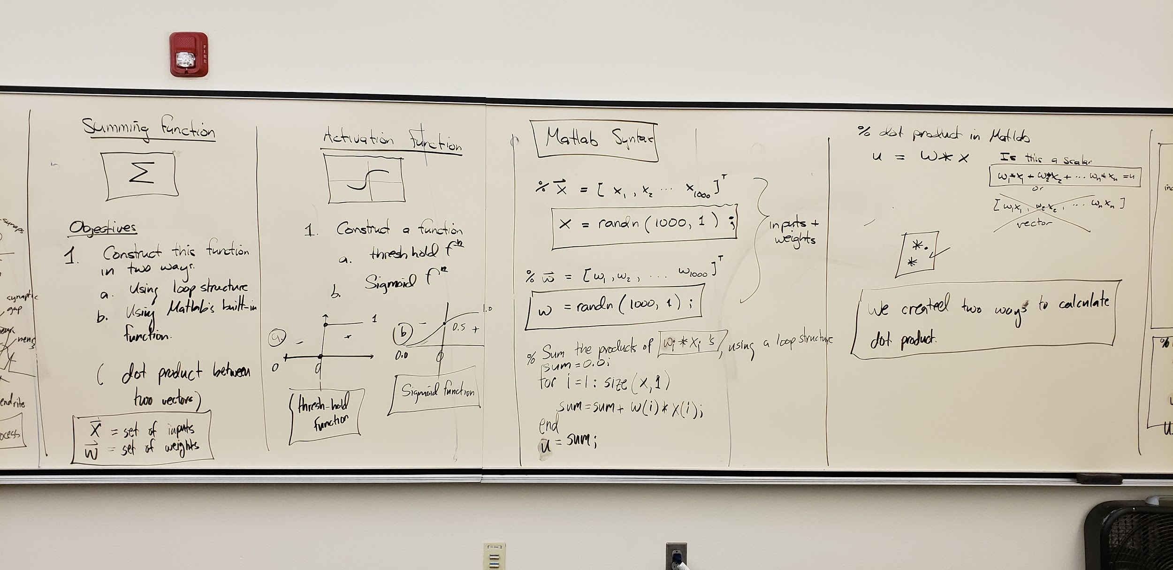

Slide 7
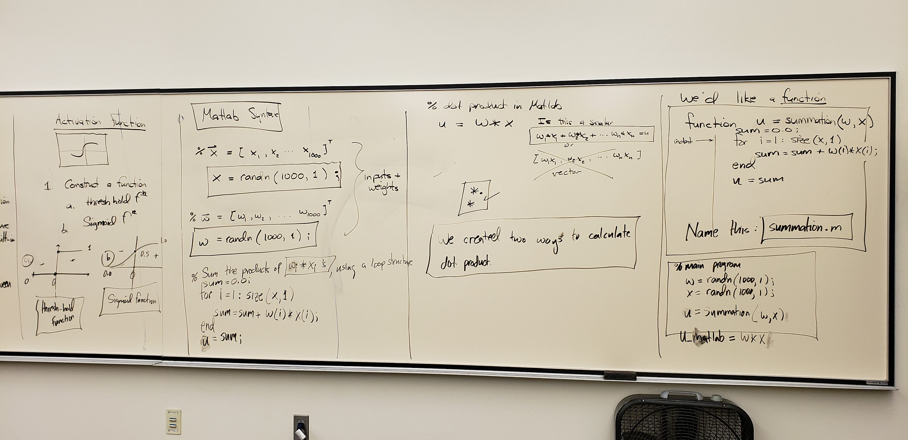

Slide 8
LECTURE #3
1-28-2020 SCROLL ON FOR LECTURE 4, LECTURE 5, ETC...

Slide 9
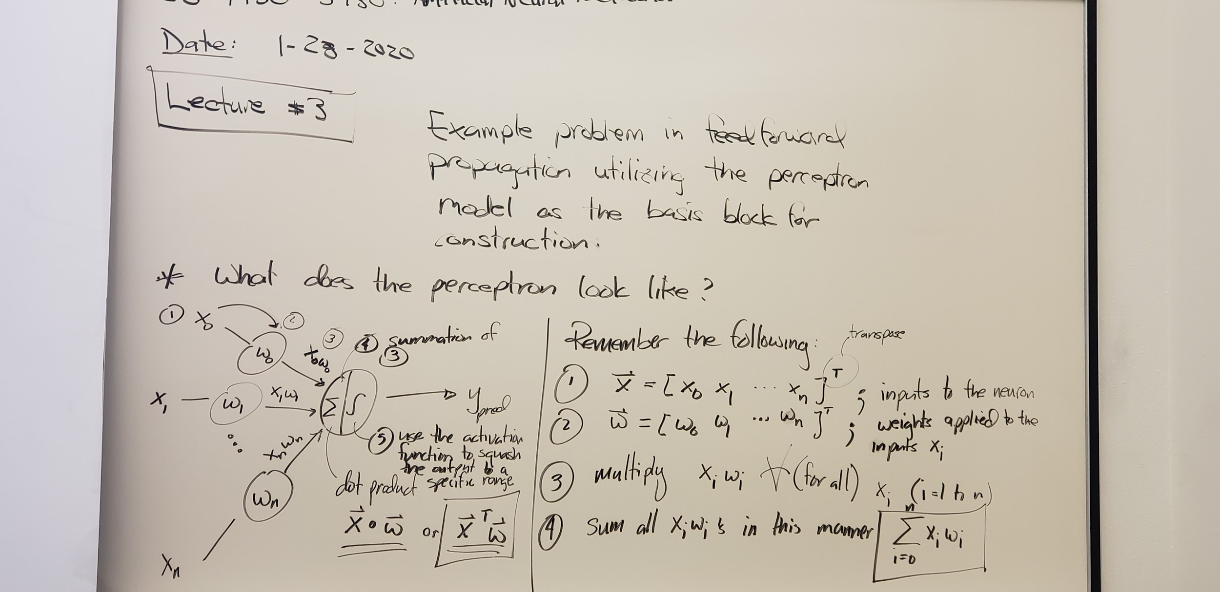

Slide 10
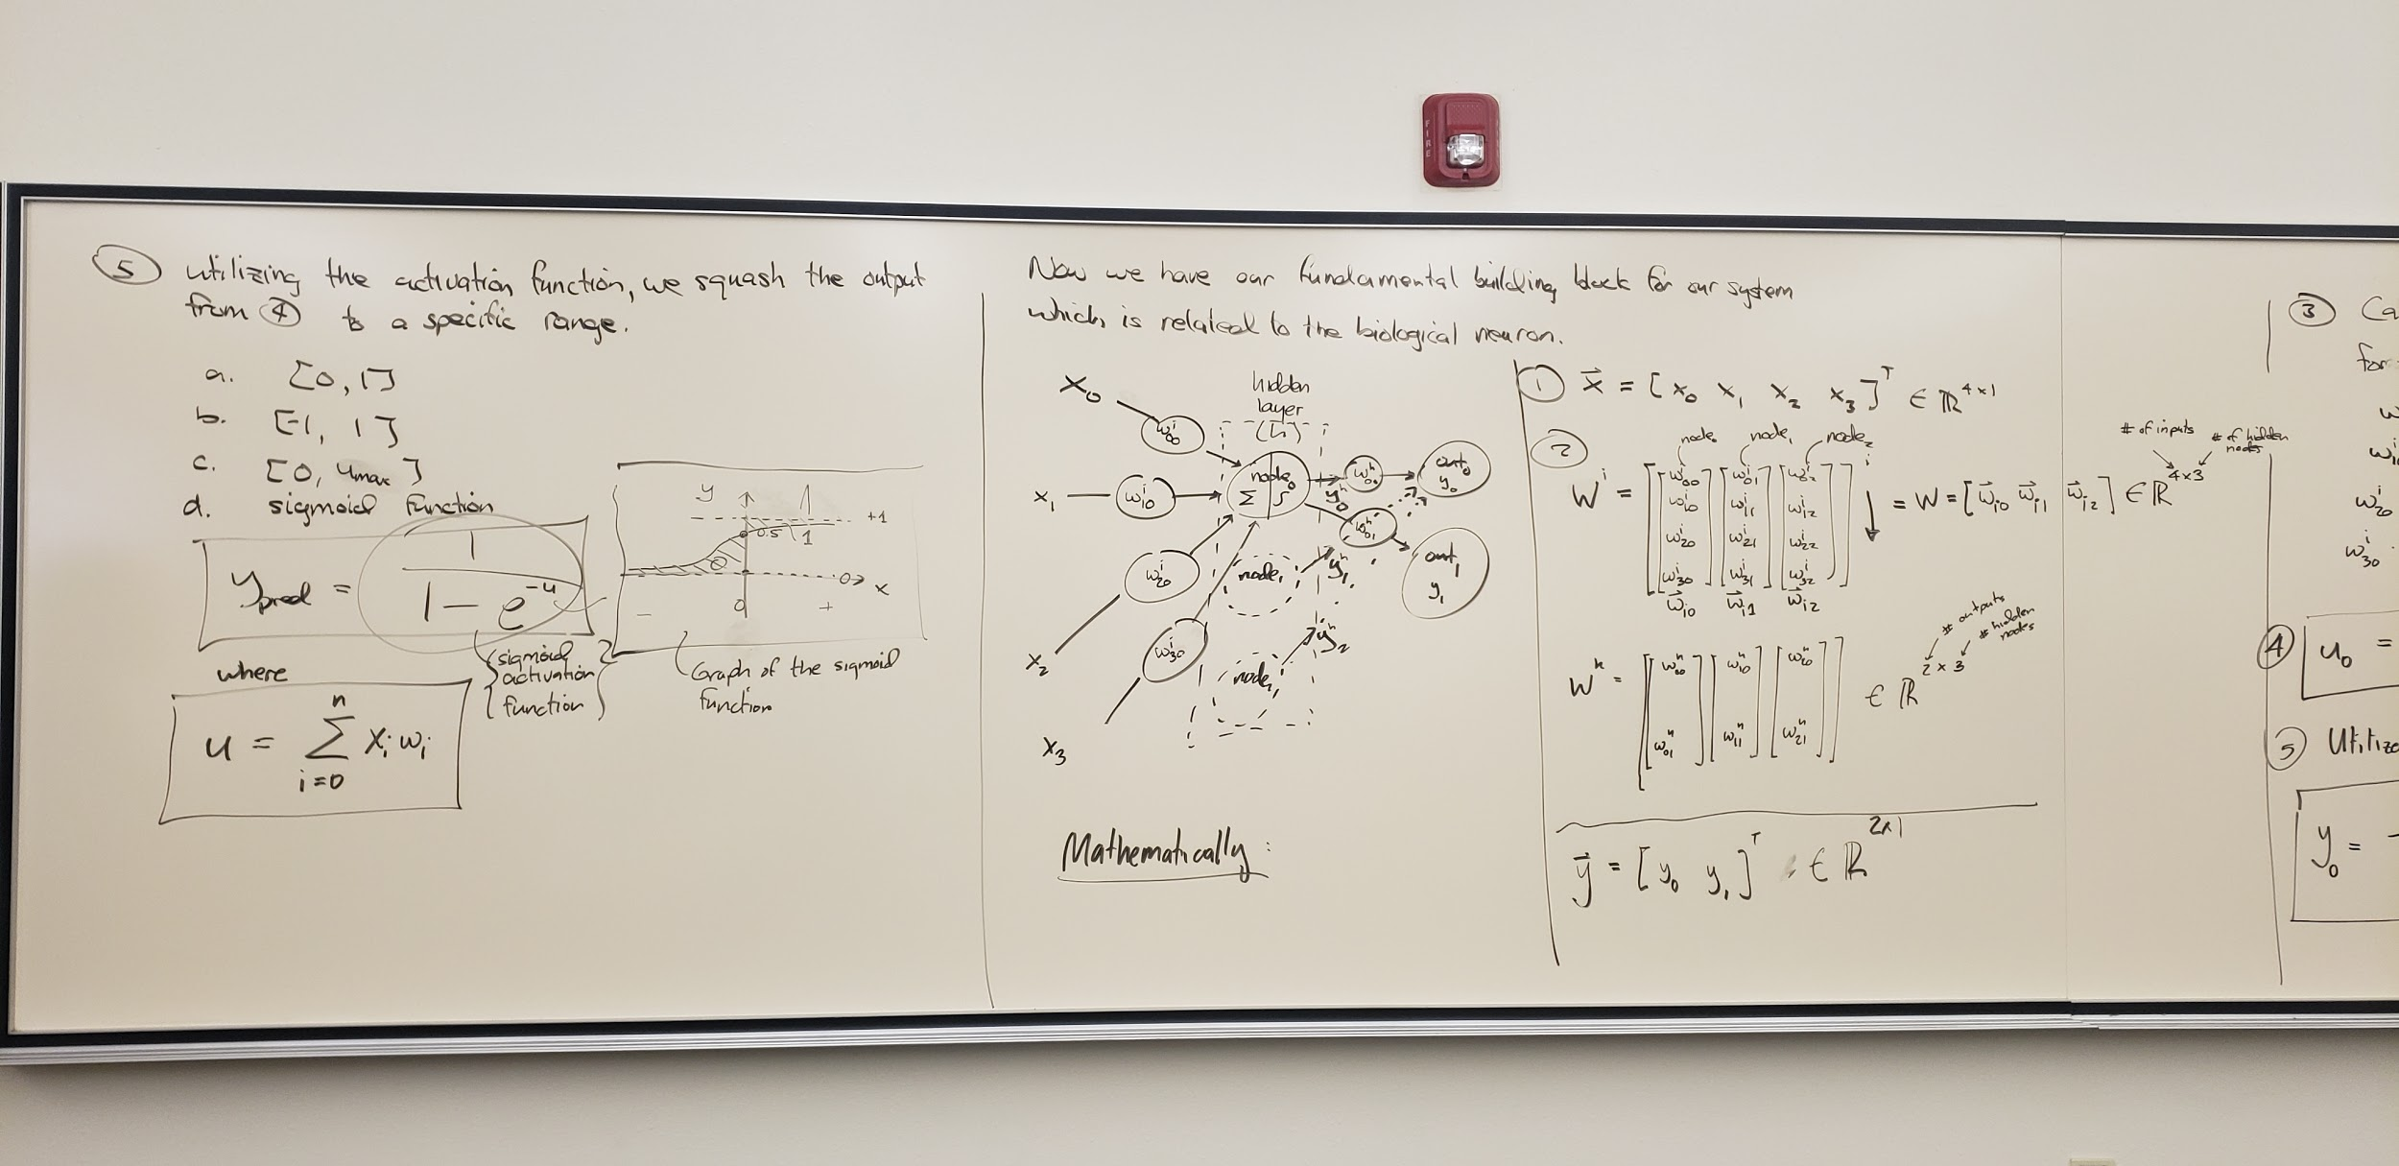

Slide 11
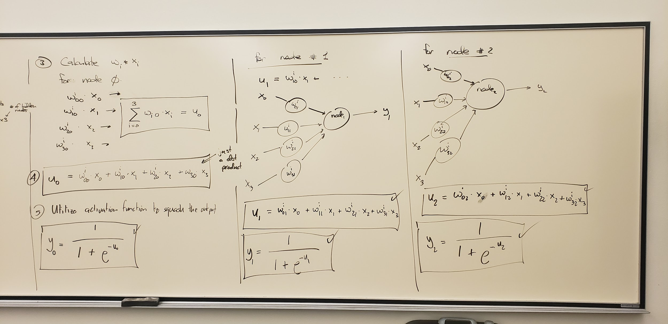

Slide 12
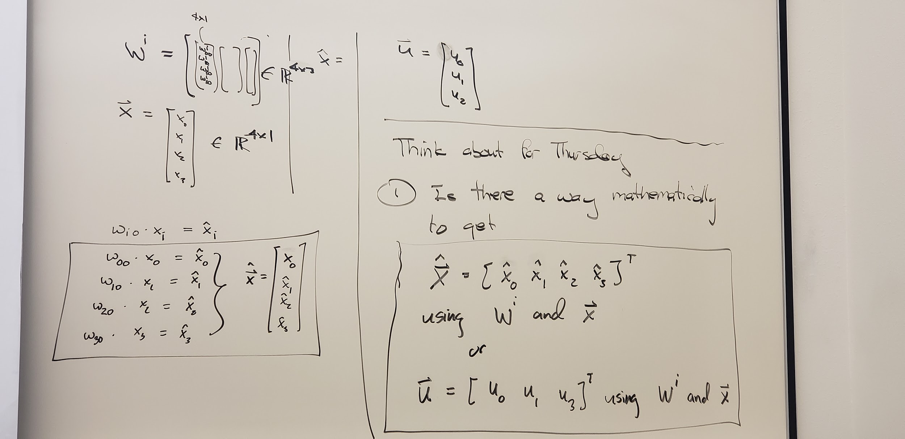

Slide 13
LECTURE #4
1-30-2020 SCROLL

Slide 14
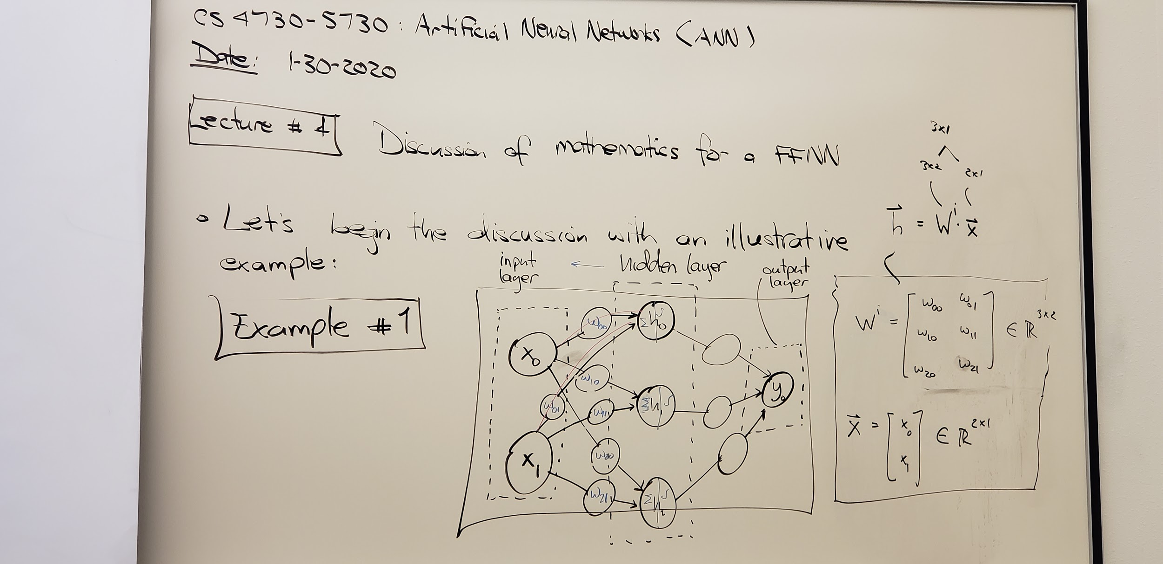

Slide 15
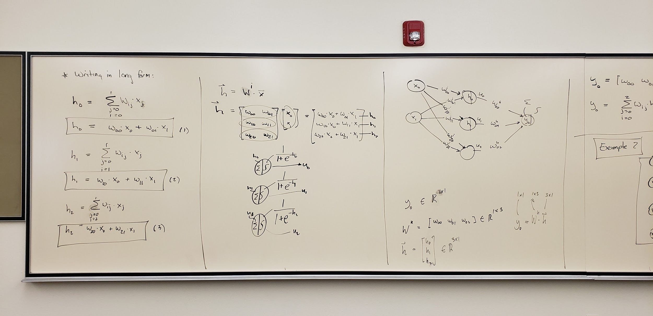

Slide 16
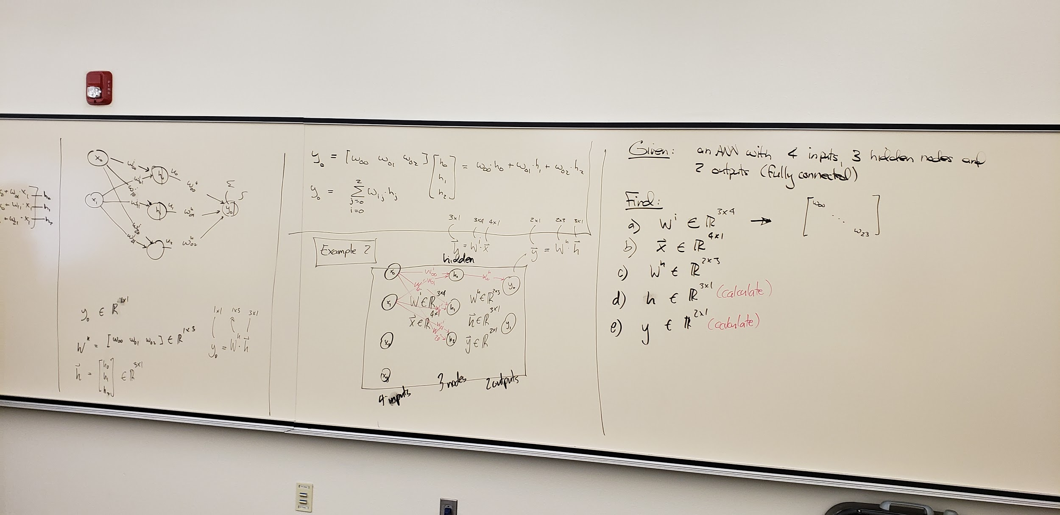

Slide 17
LECTURE #5
2-5-2020
Classes were limited on this day due to the snow but Dr. Gallegos still had some in attendance and there are still notes so review as needed.

Slide 18
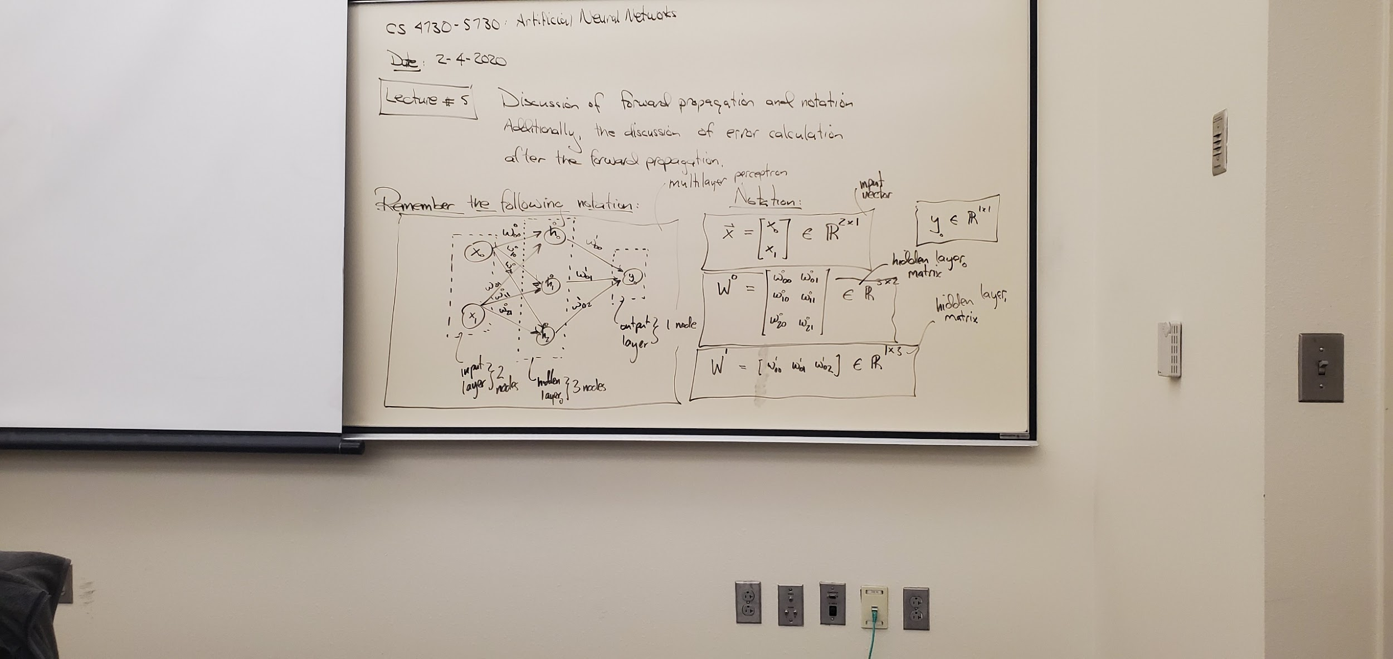

Slide 19
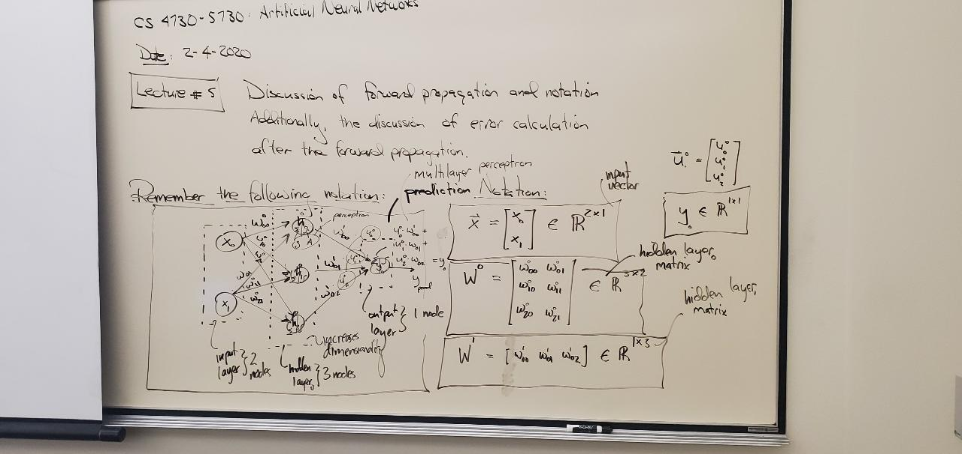

Slide 20
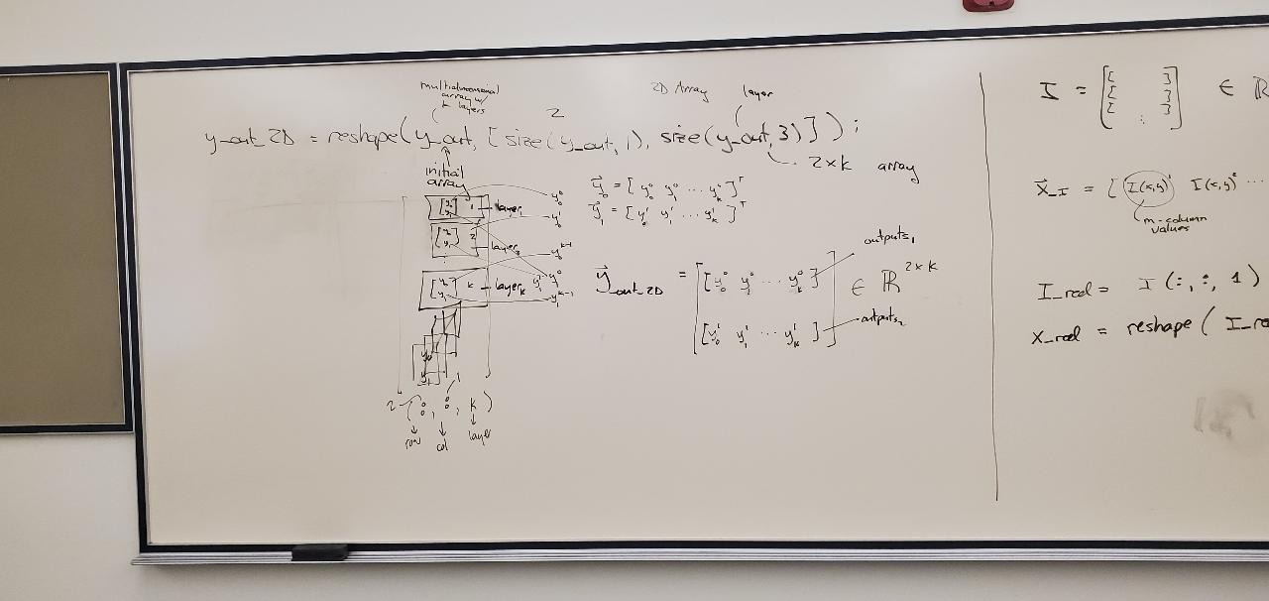

Slide 21
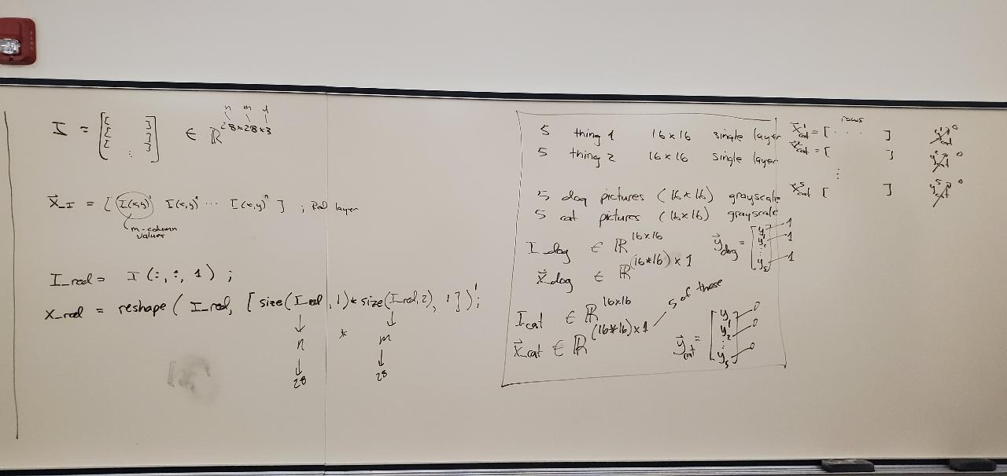

Slide 22
LECTURE #6
2-6-2020

Slide 23
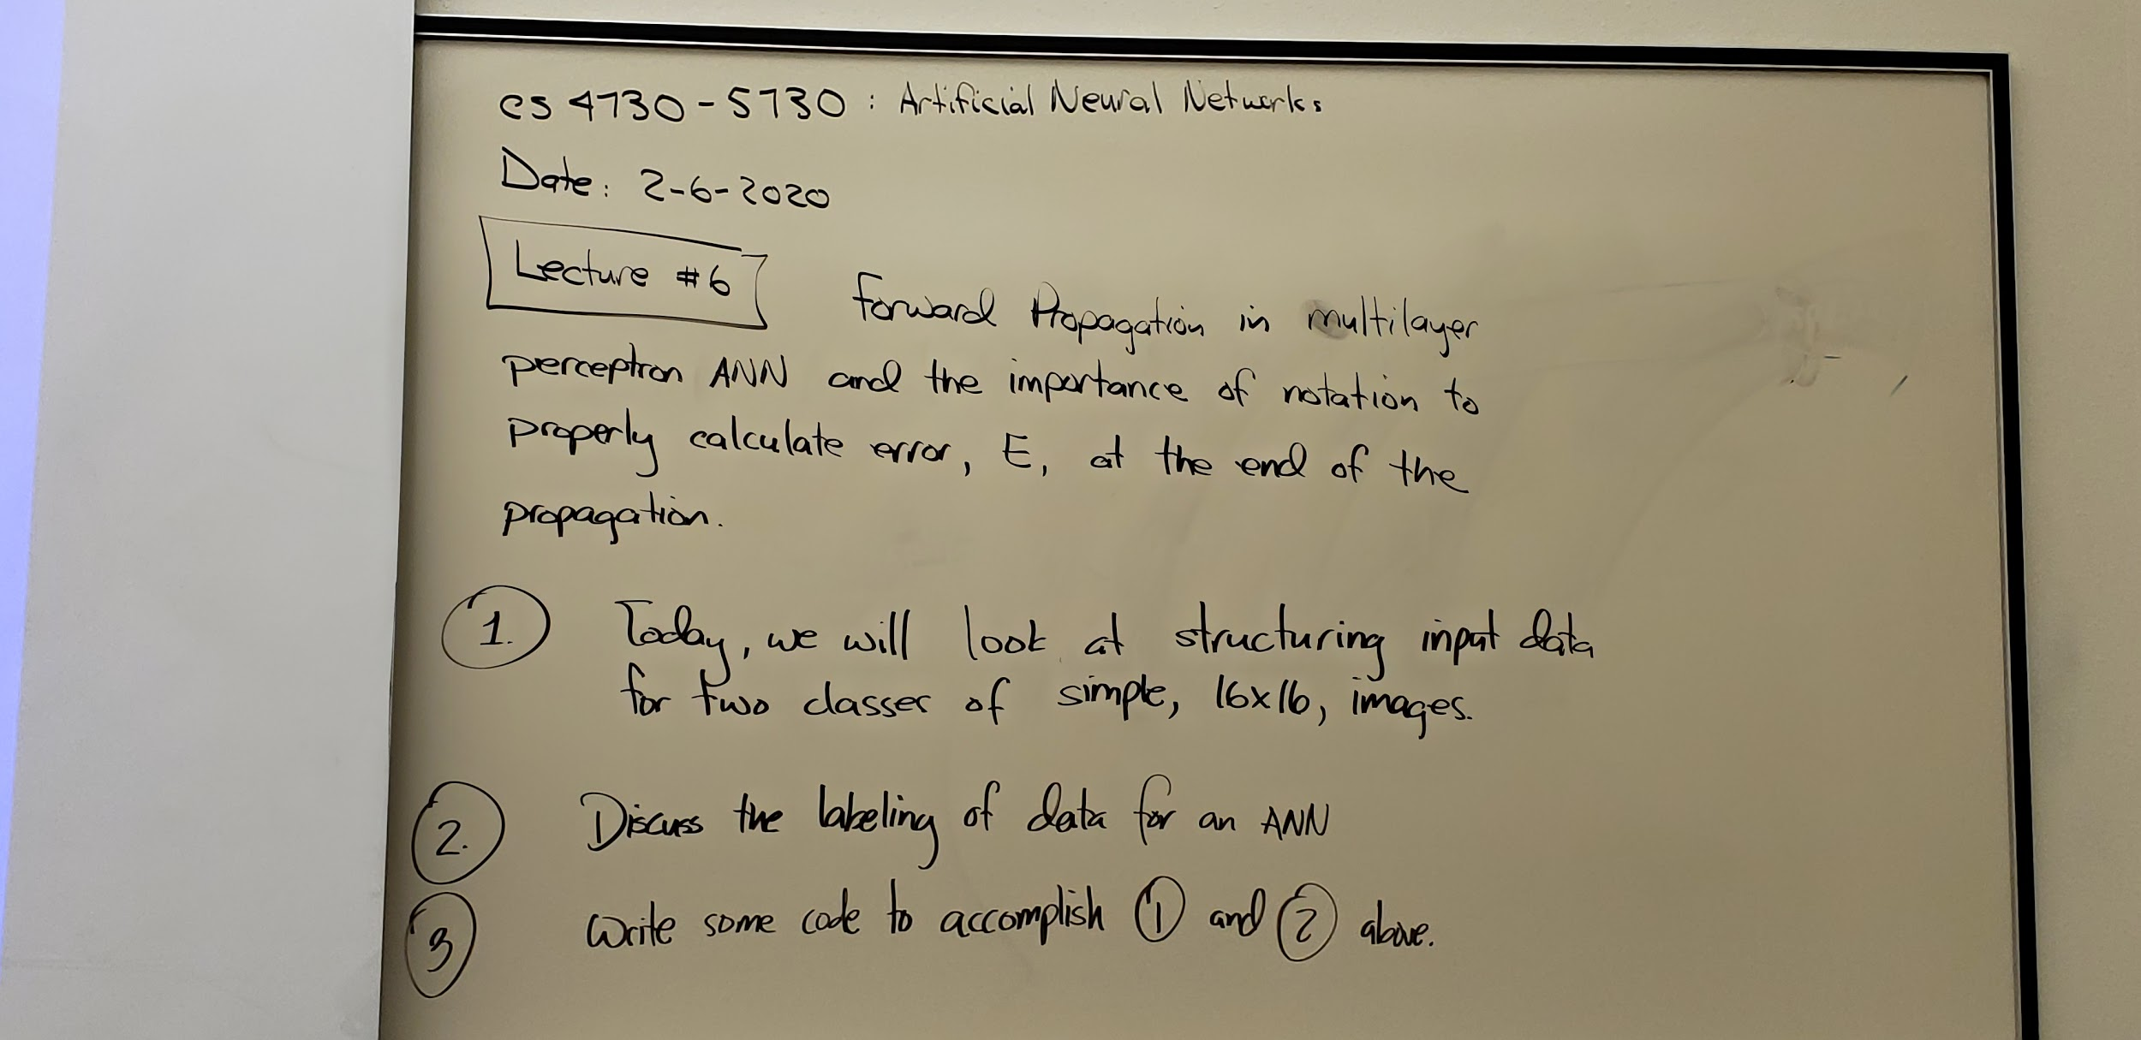

Slide 24
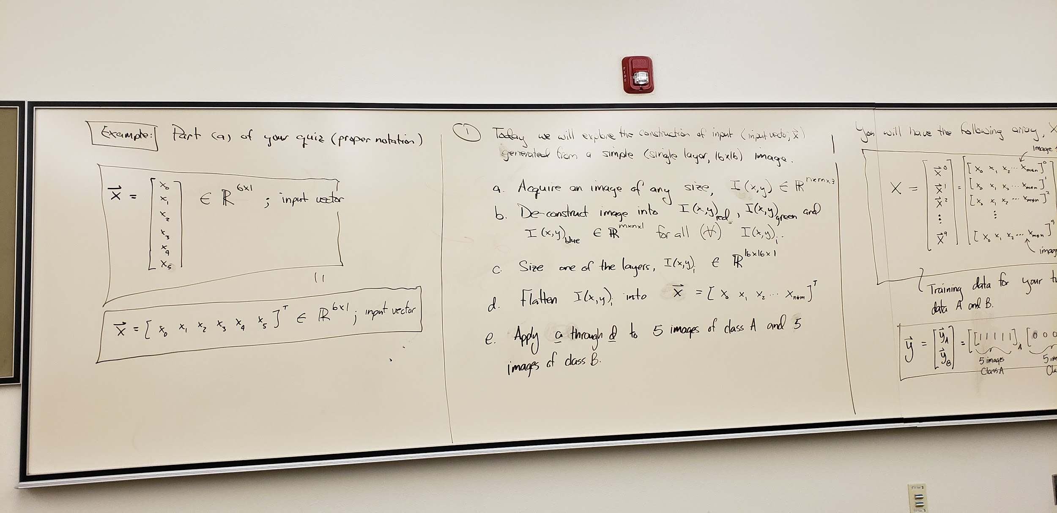

Slide 25
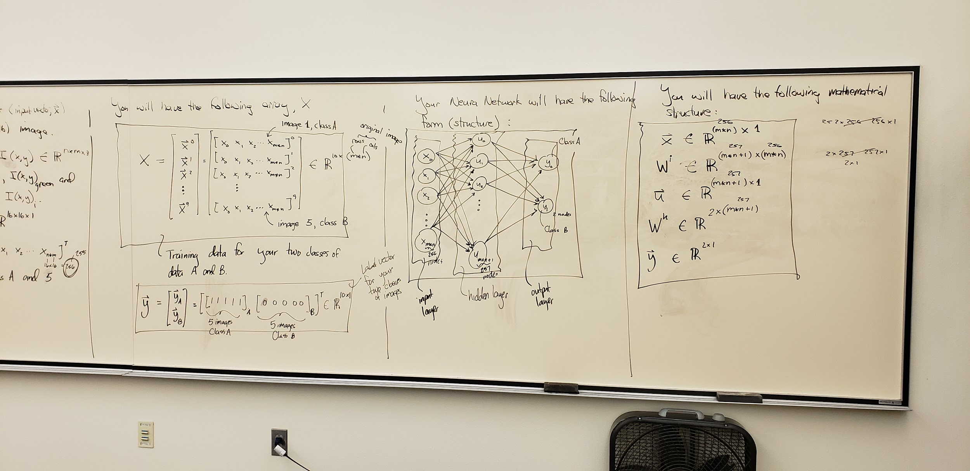

Slide 26
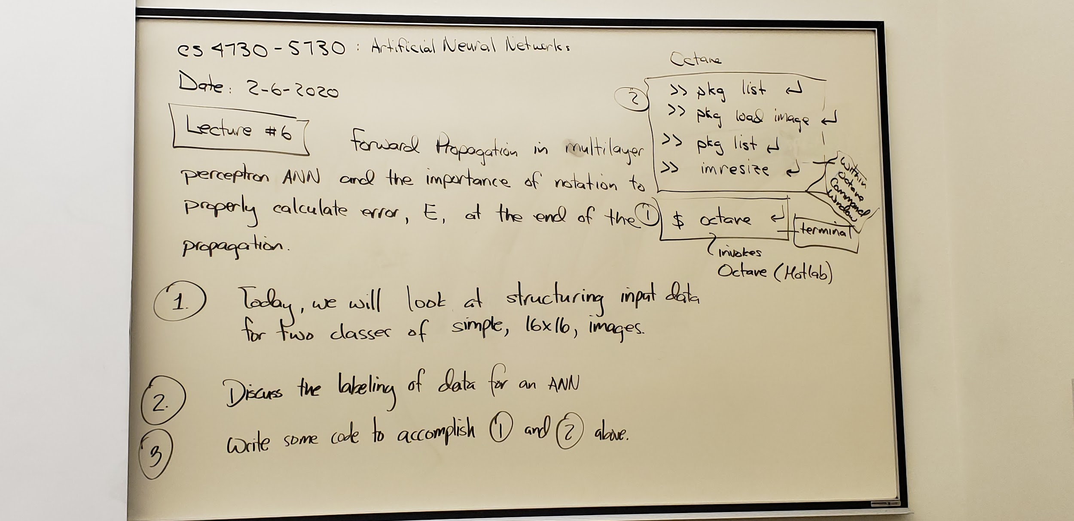

Slide 27
LECTURE #7
2-13-2020

Slide 28
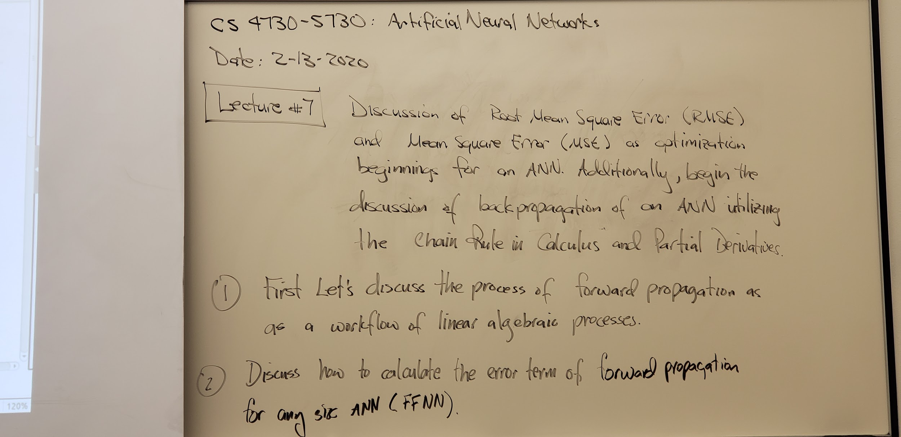

Slide 29
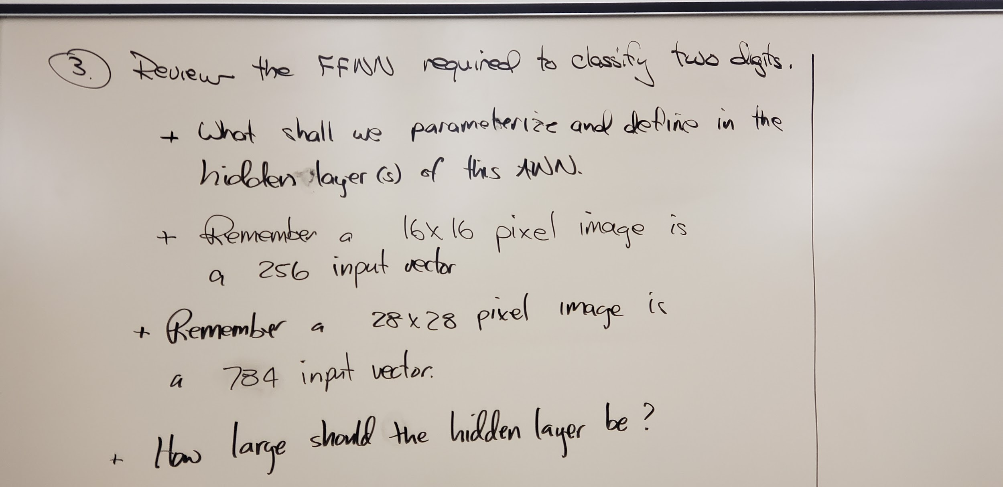

Slide 30
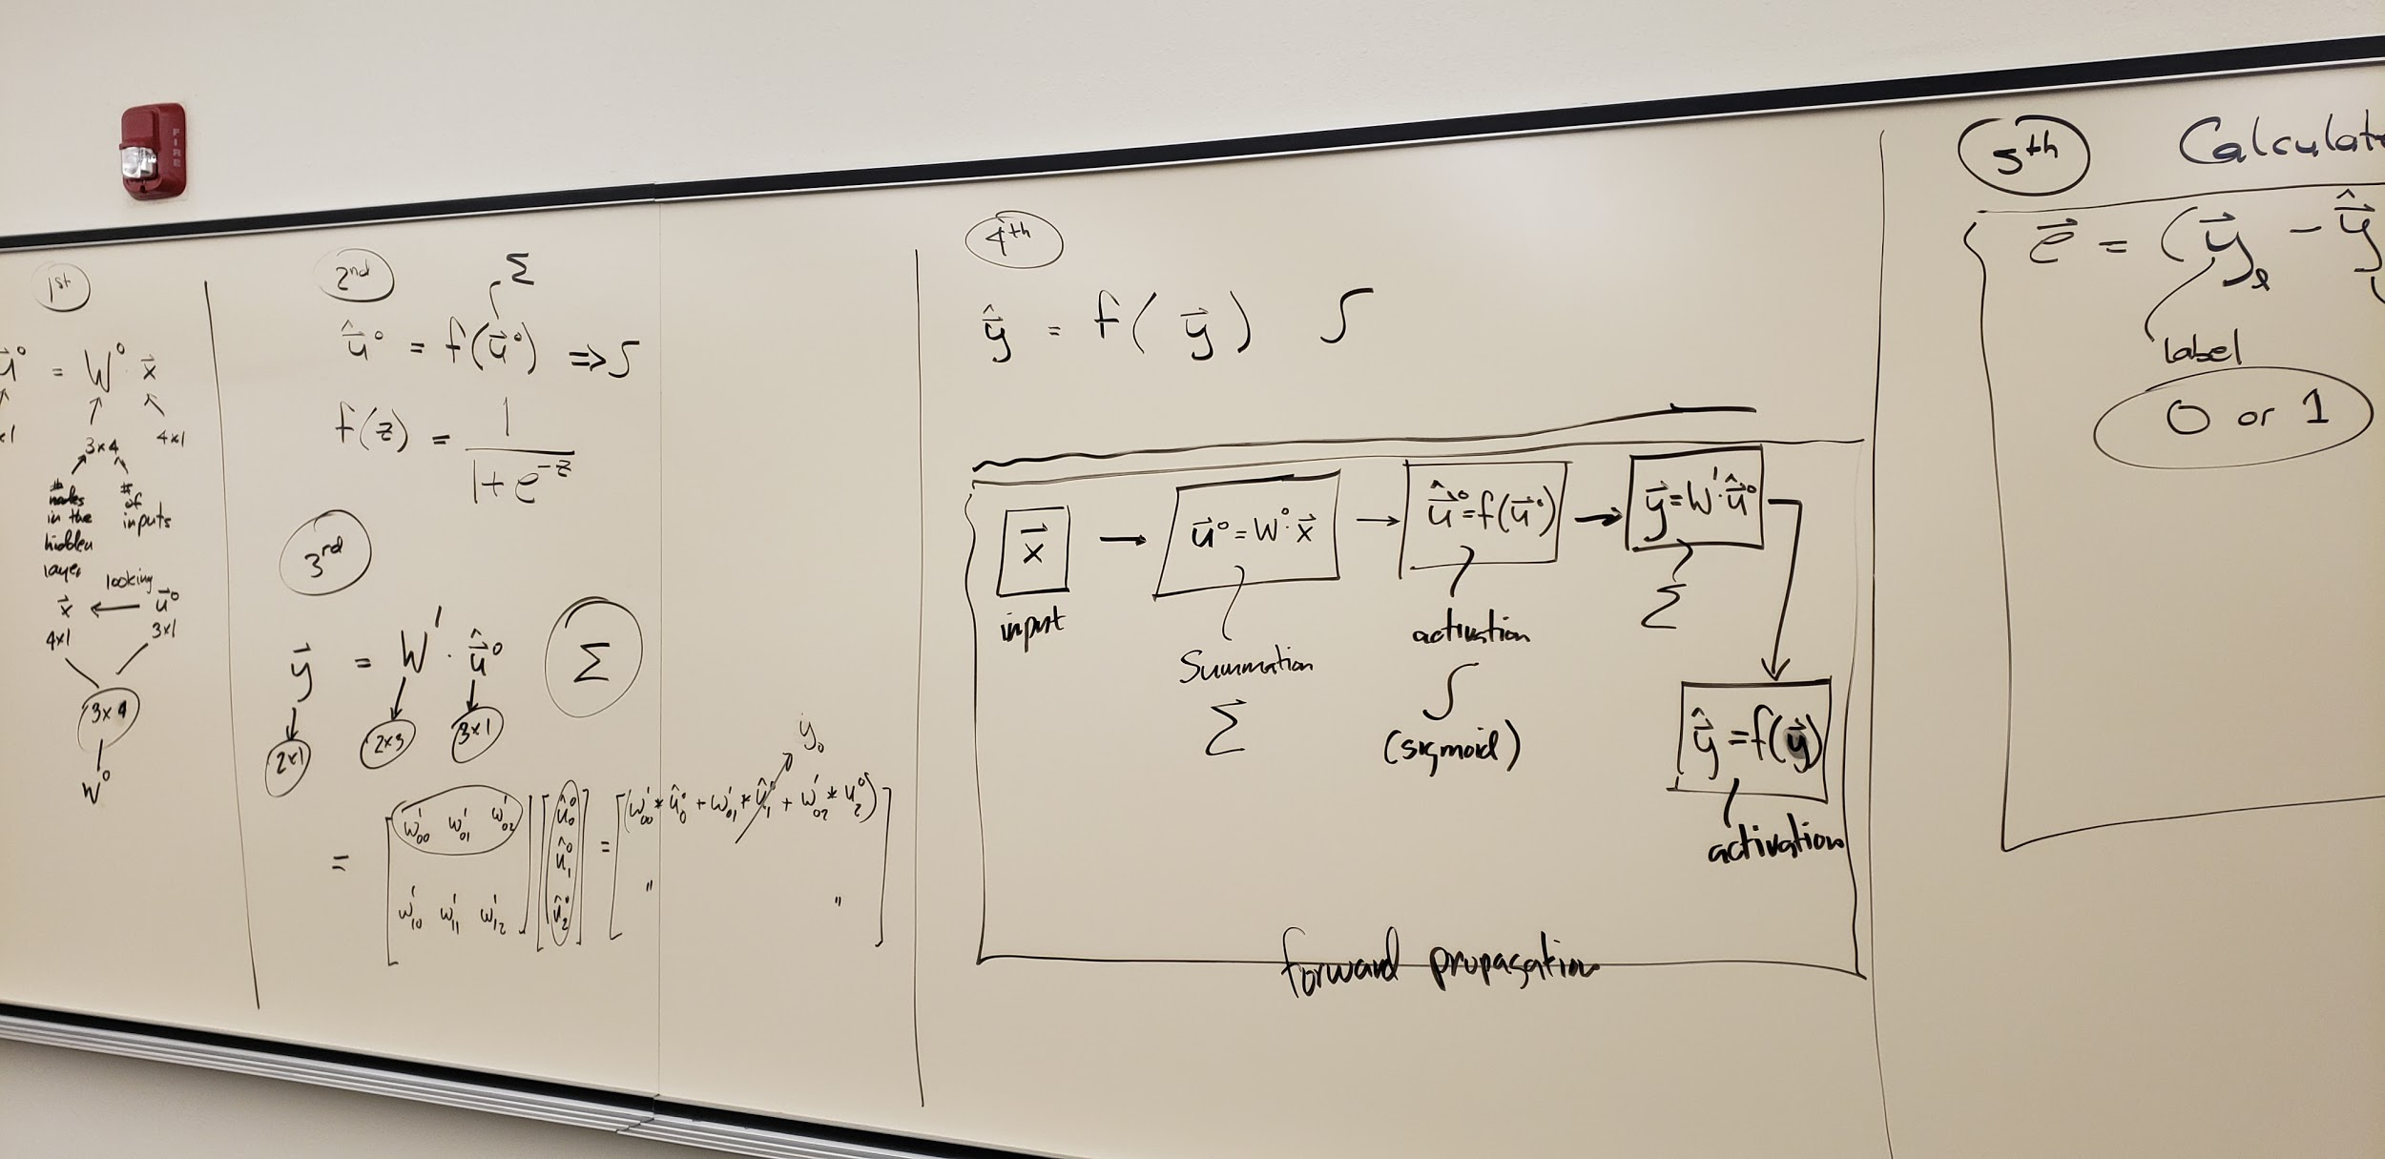

Slide 31
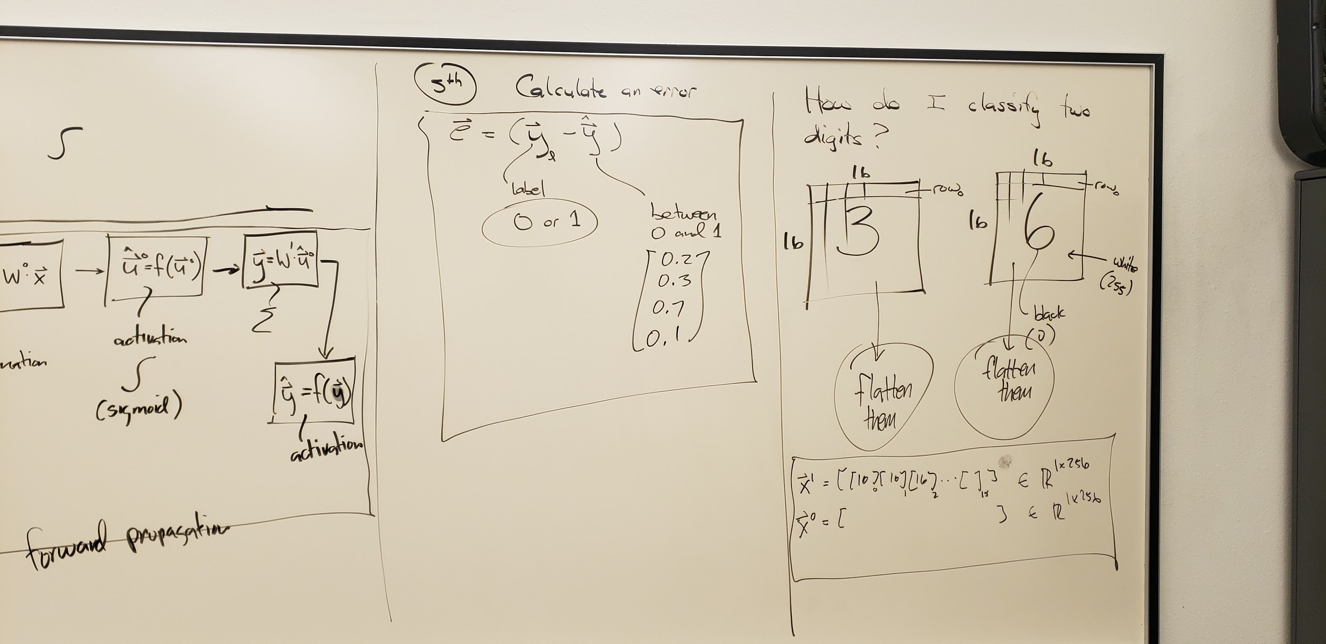

Slide 32
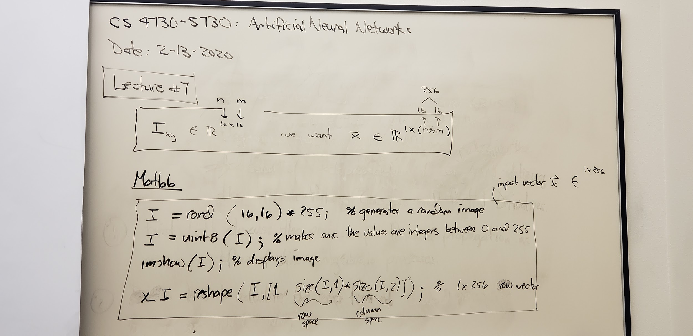

Slide 33
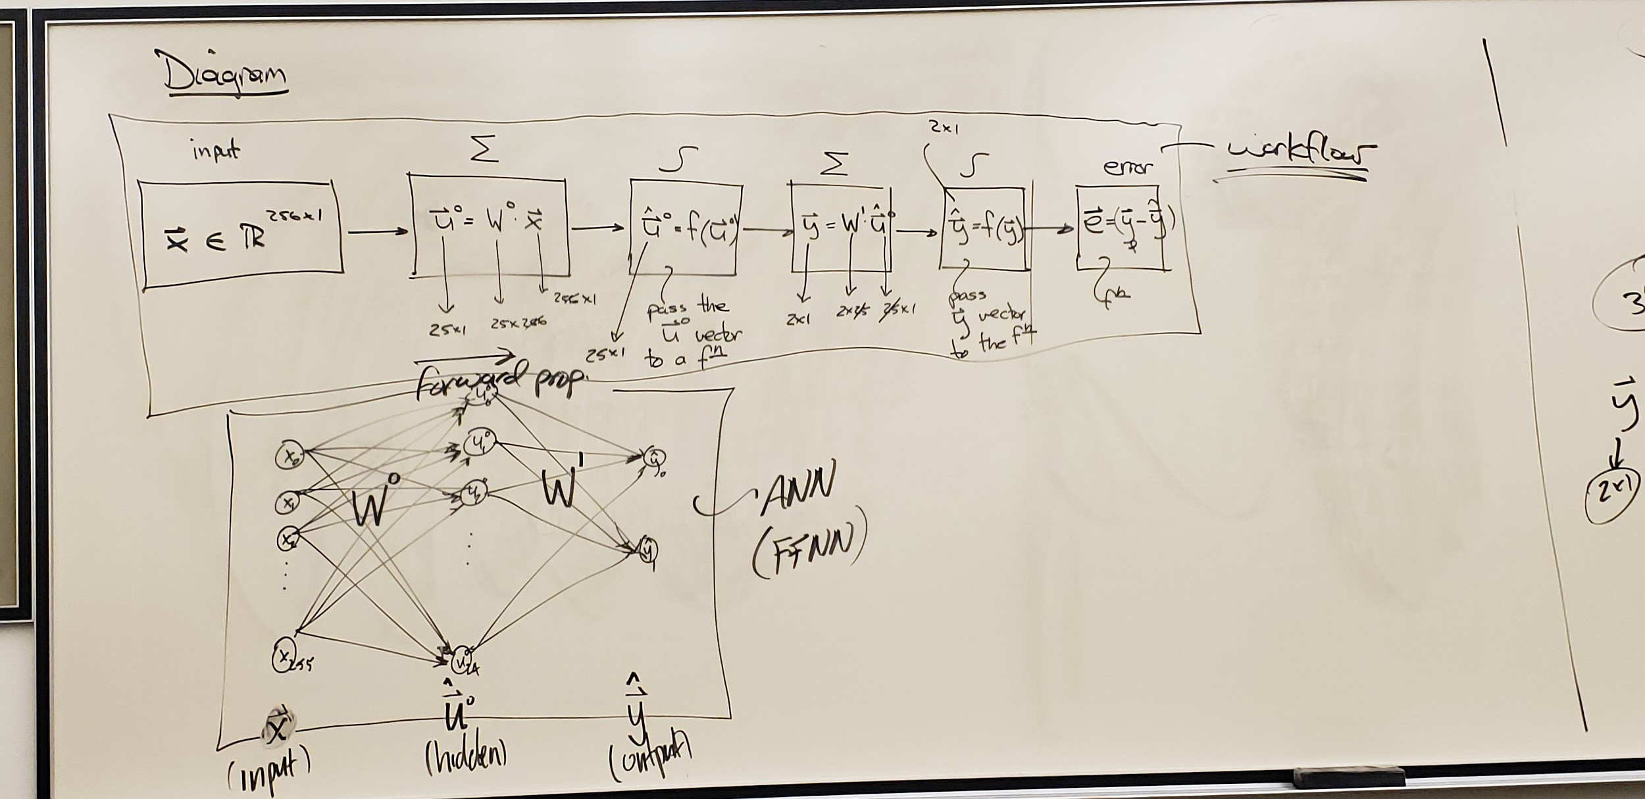

Slide 34
LECTURE #8
2-18-2020

Slide 35
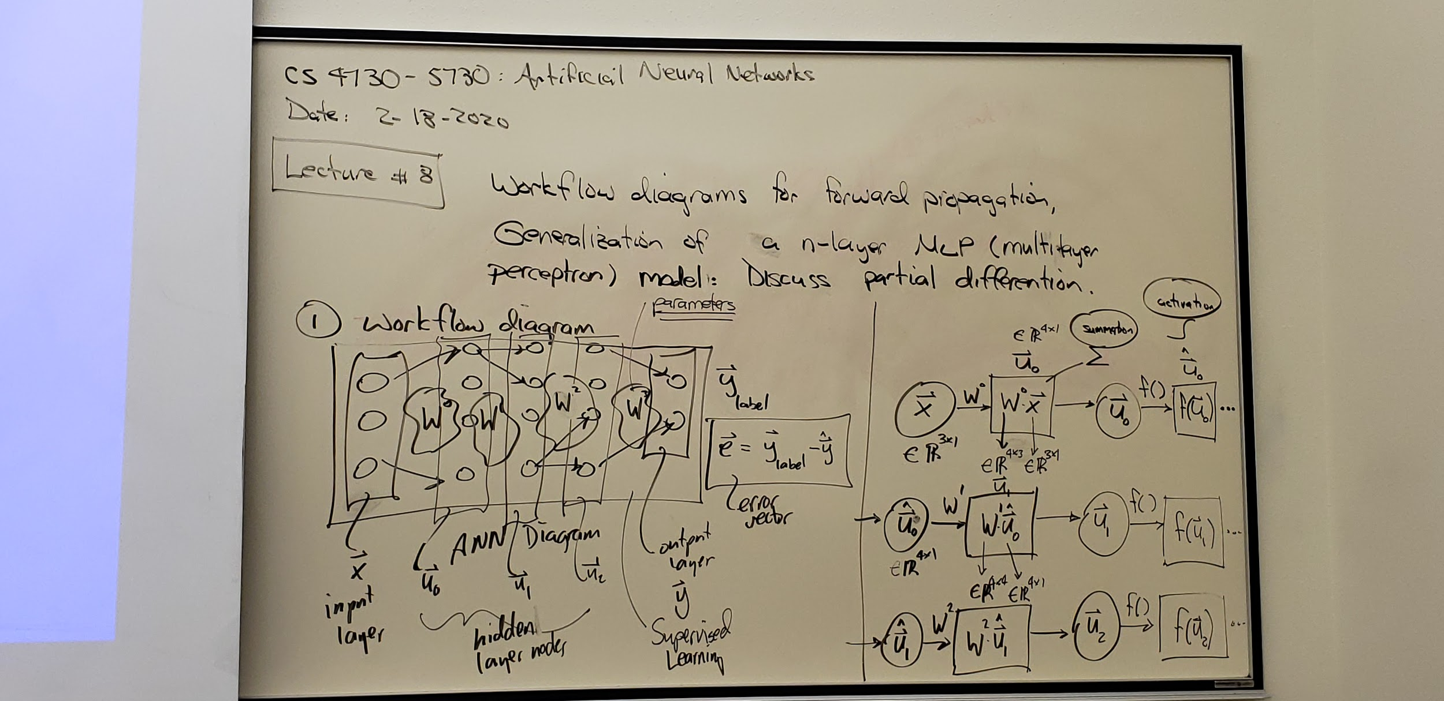

Slide 36
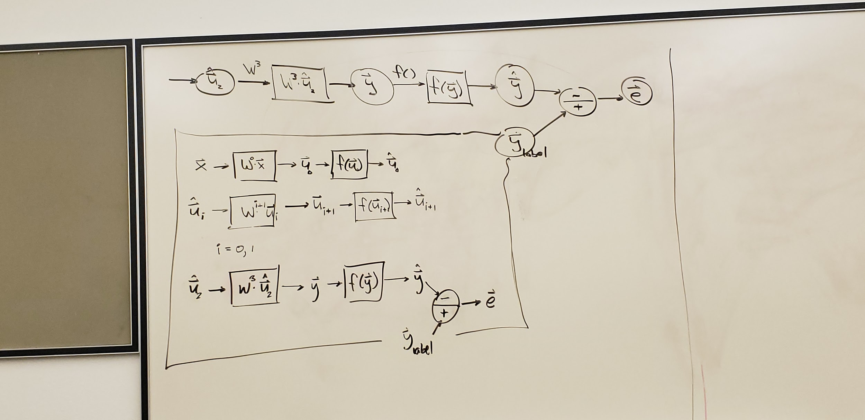

Slide 37
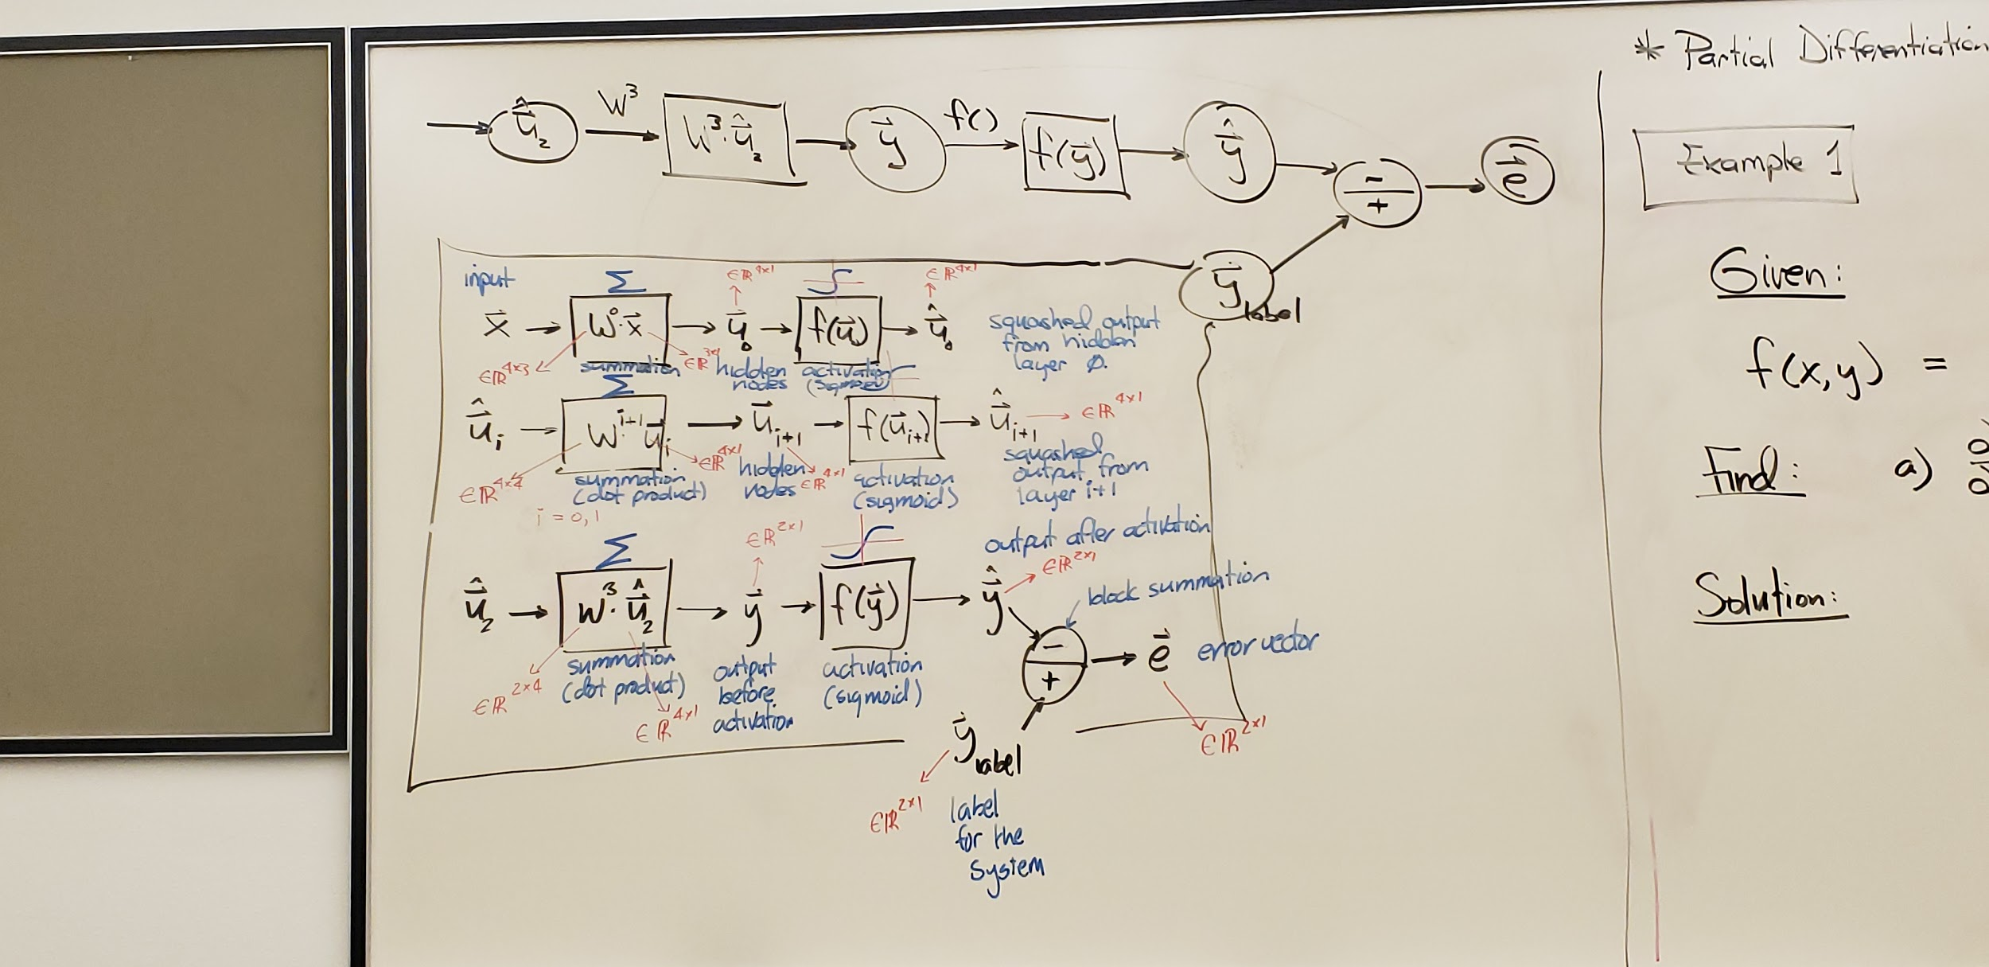

Slide 38
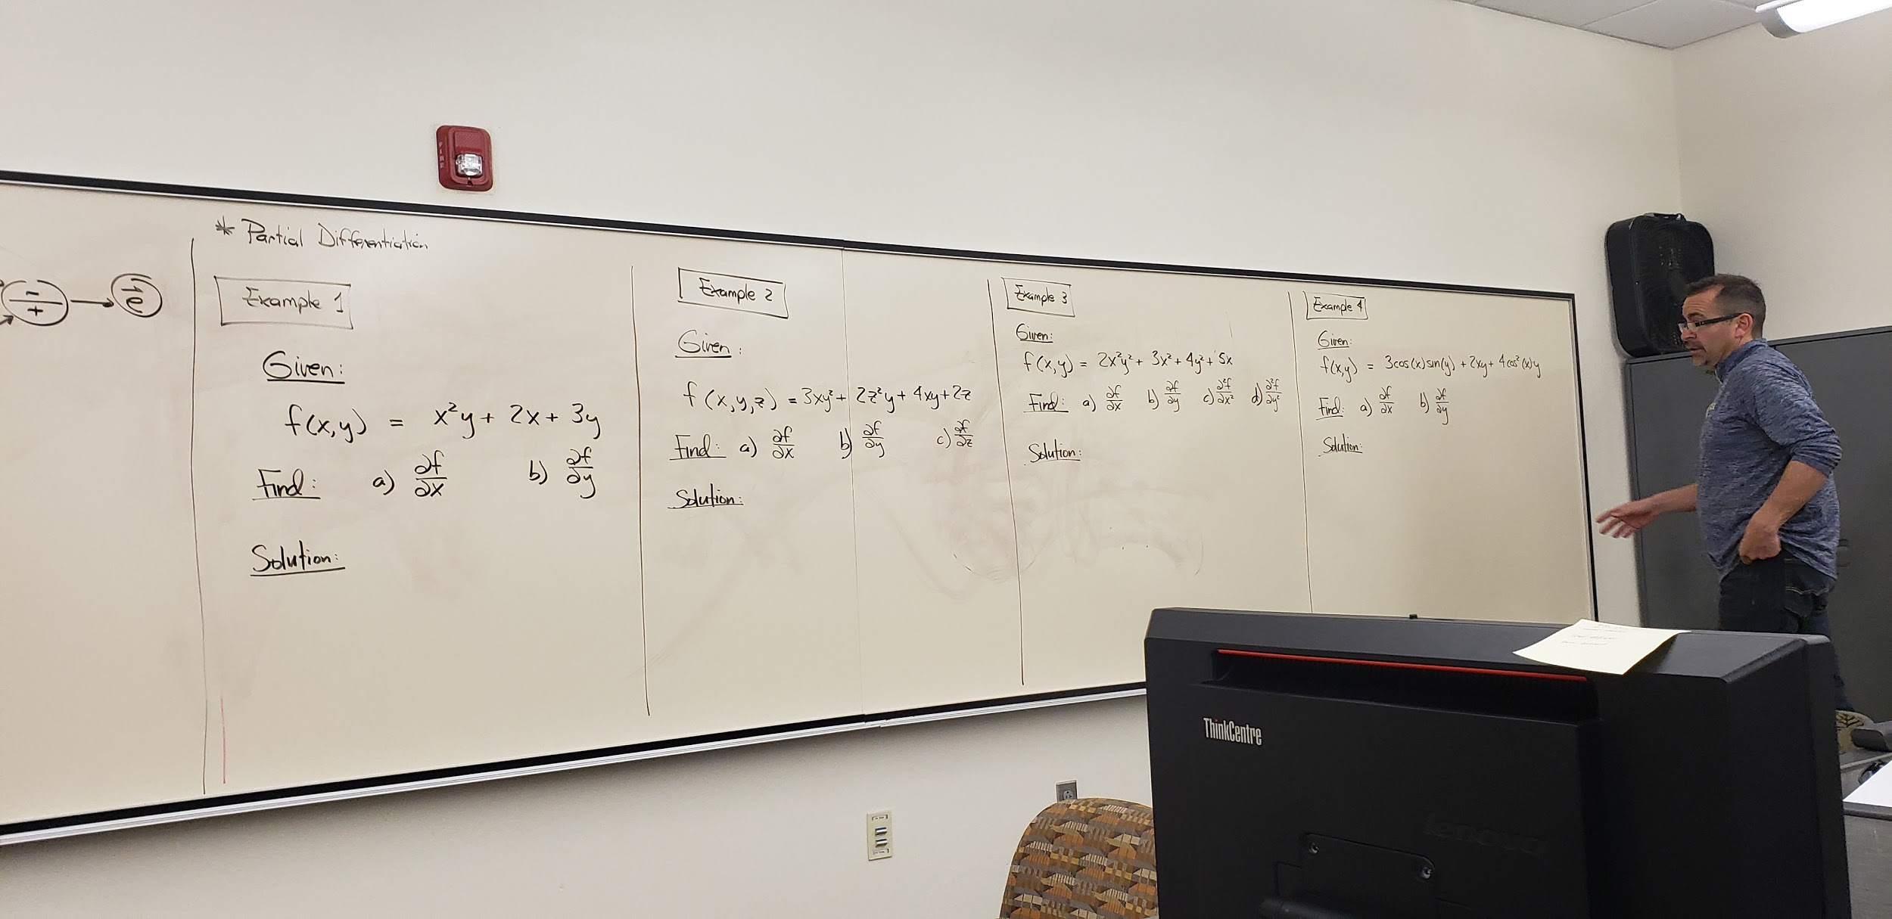

Slide 39
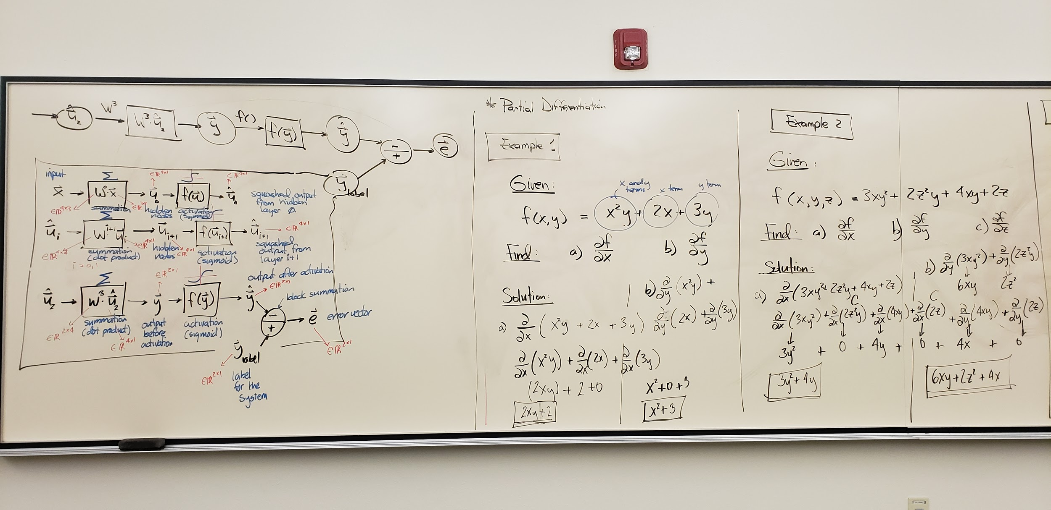

Slide 40
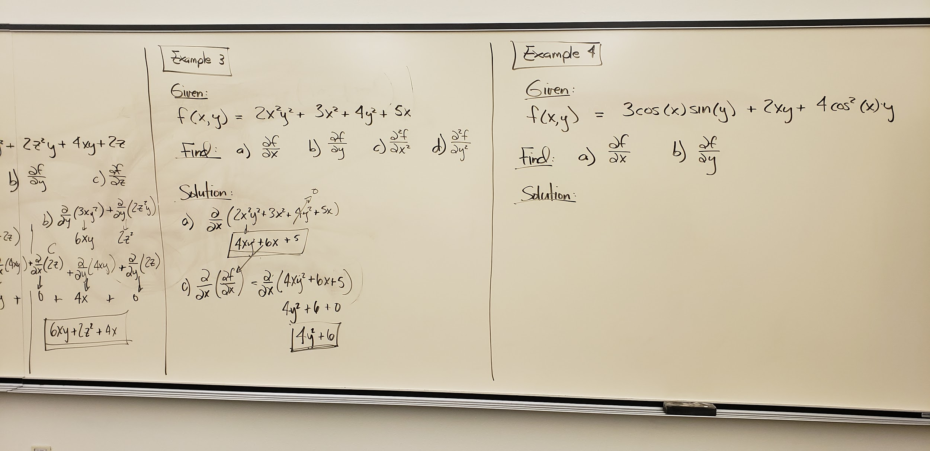

Slide 41
LECTURE #9
2-20-2020

Slide 42
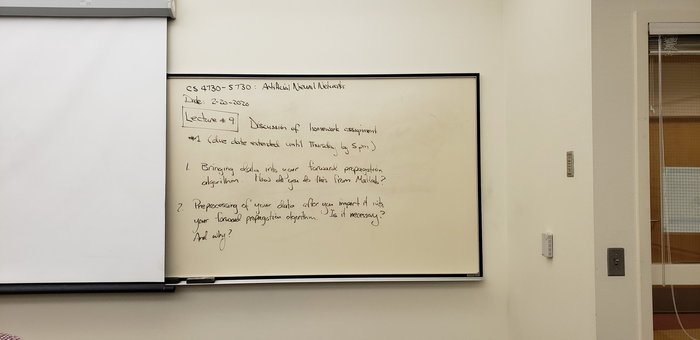

Slide 43
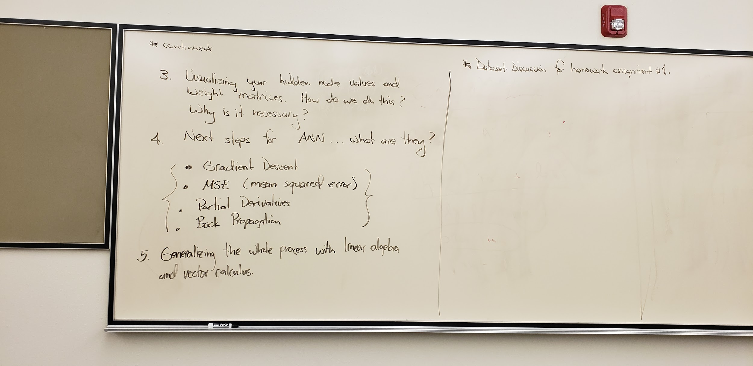

Slide 44
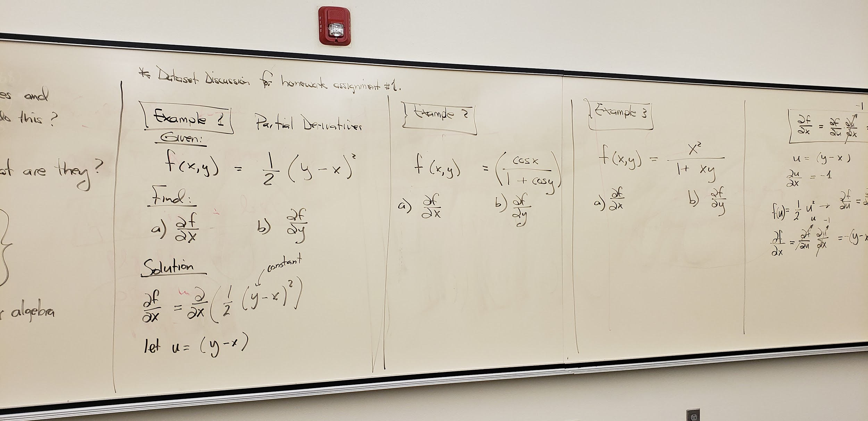

Slide 45
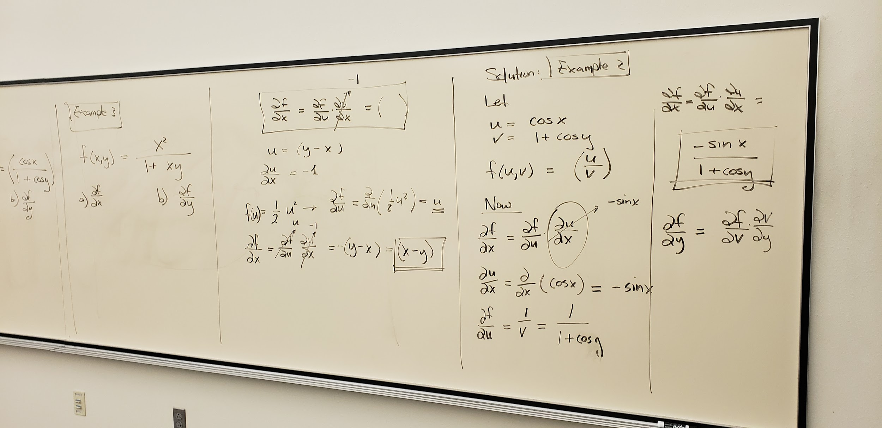

Slide 46
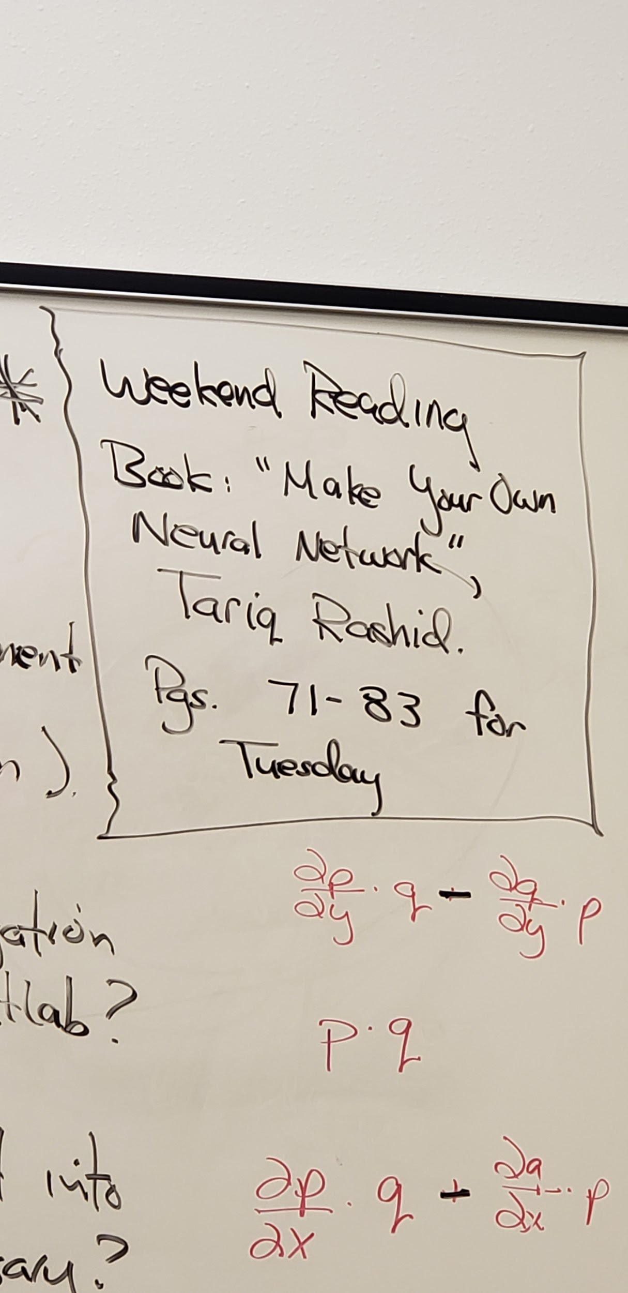

Slide 47
LECTURE #12
2-27-2020

Slide 48
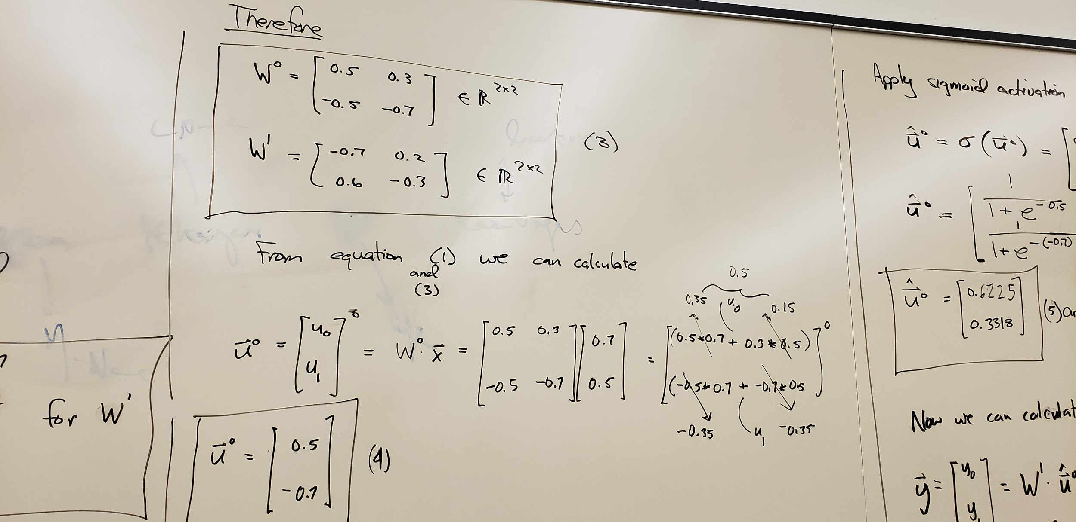
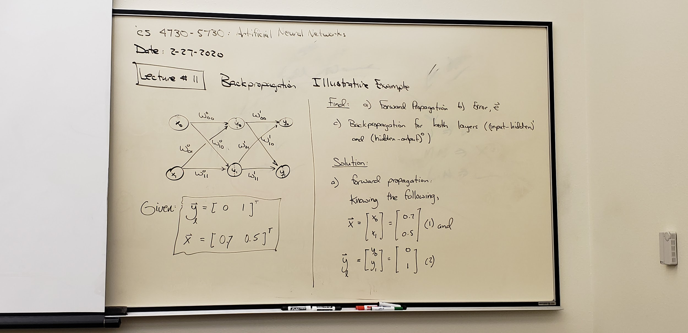

Slide 49
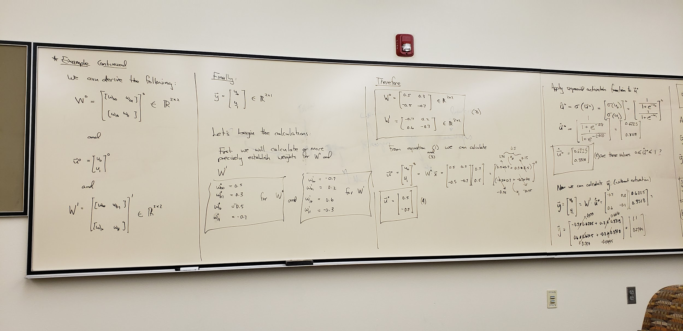

Slide 50
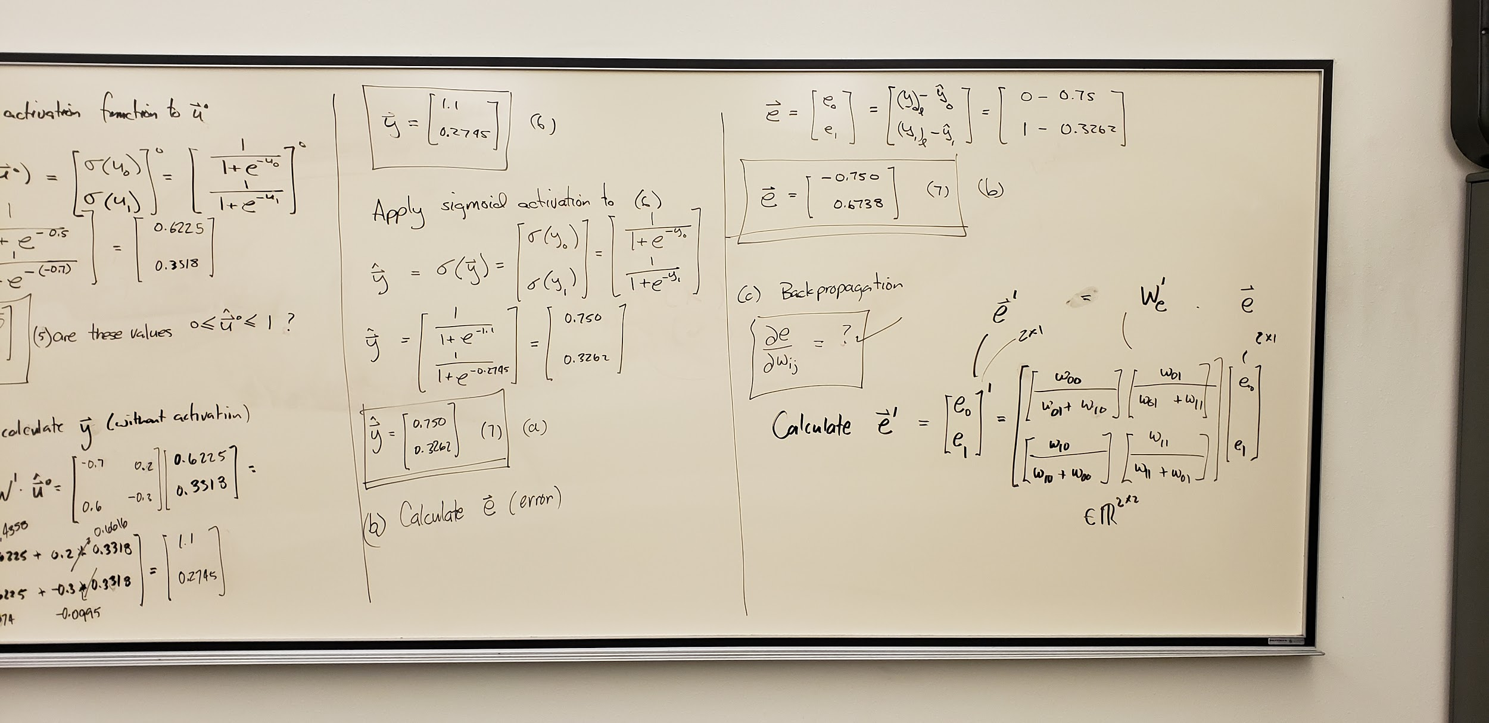

Slide 51
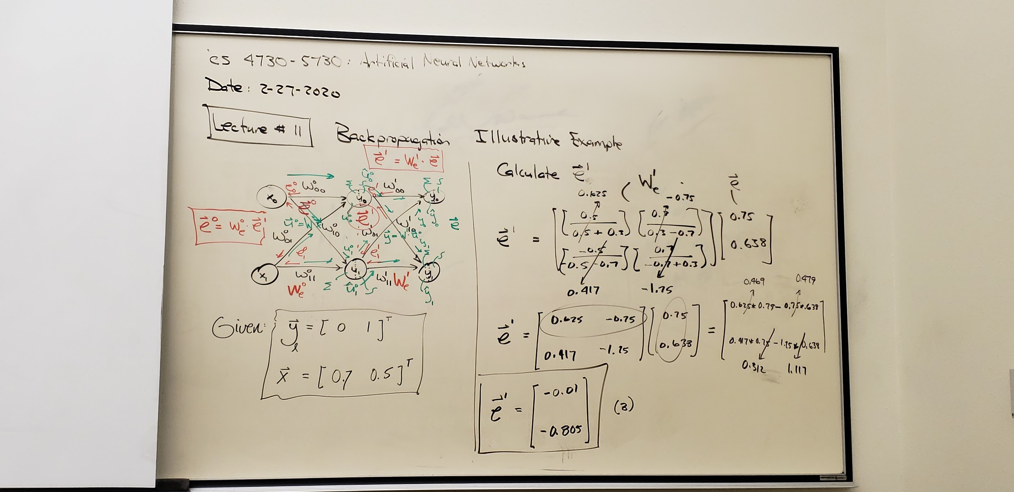

Slide 52
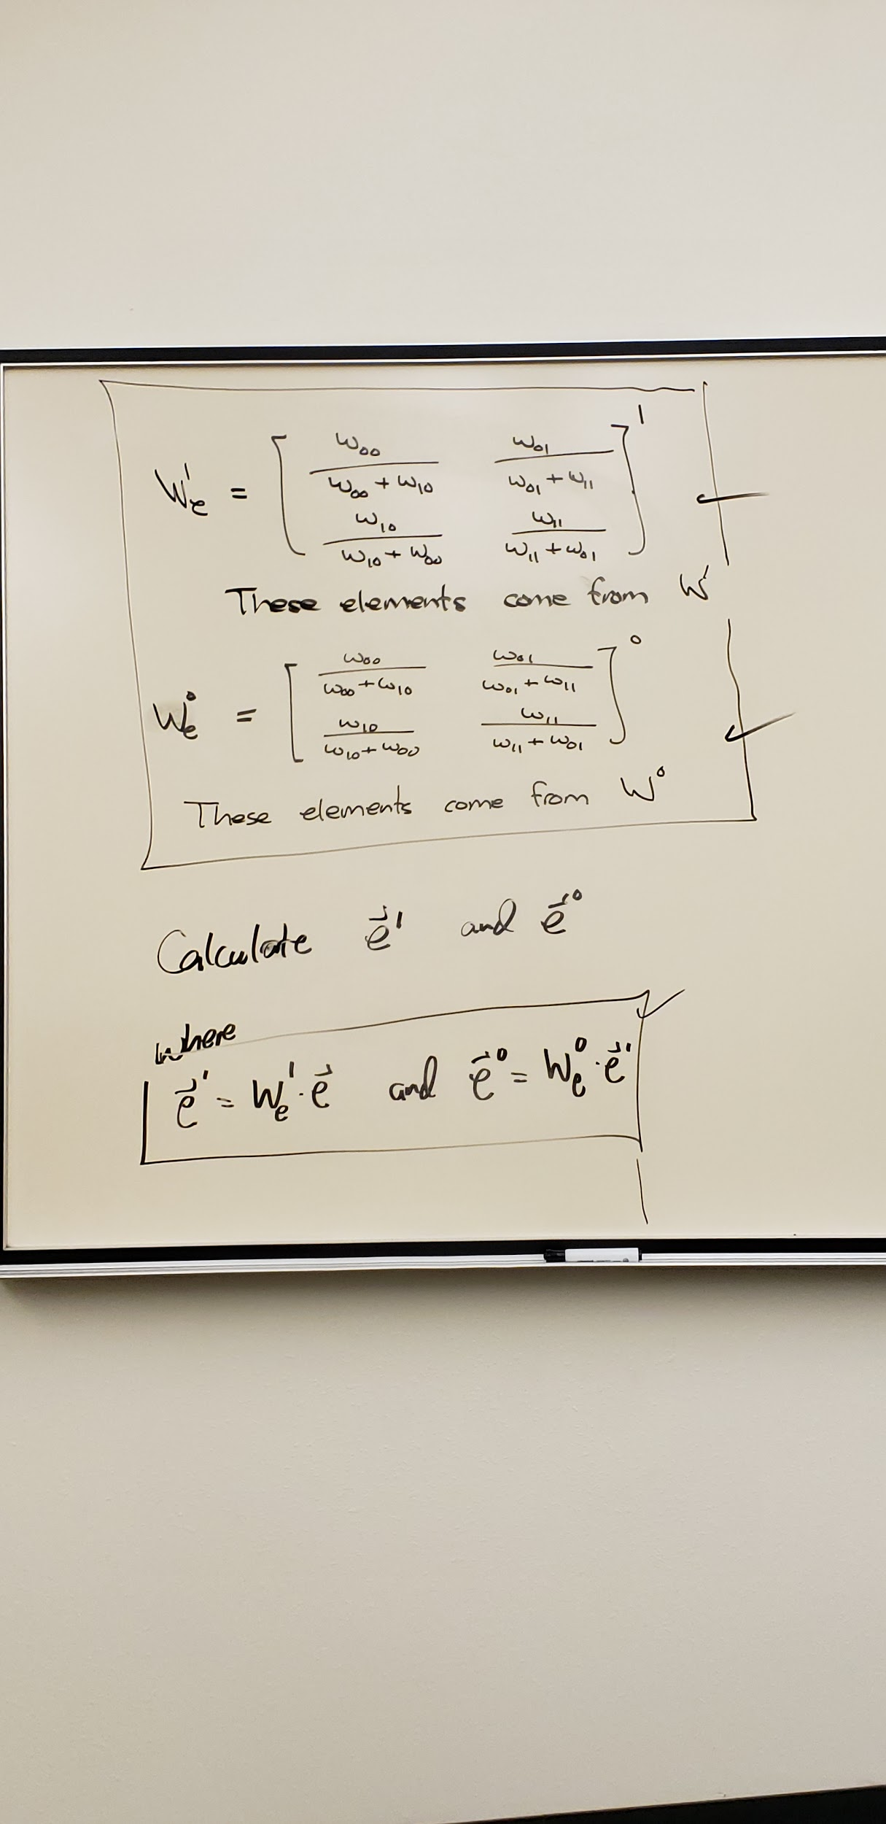

Slide 53
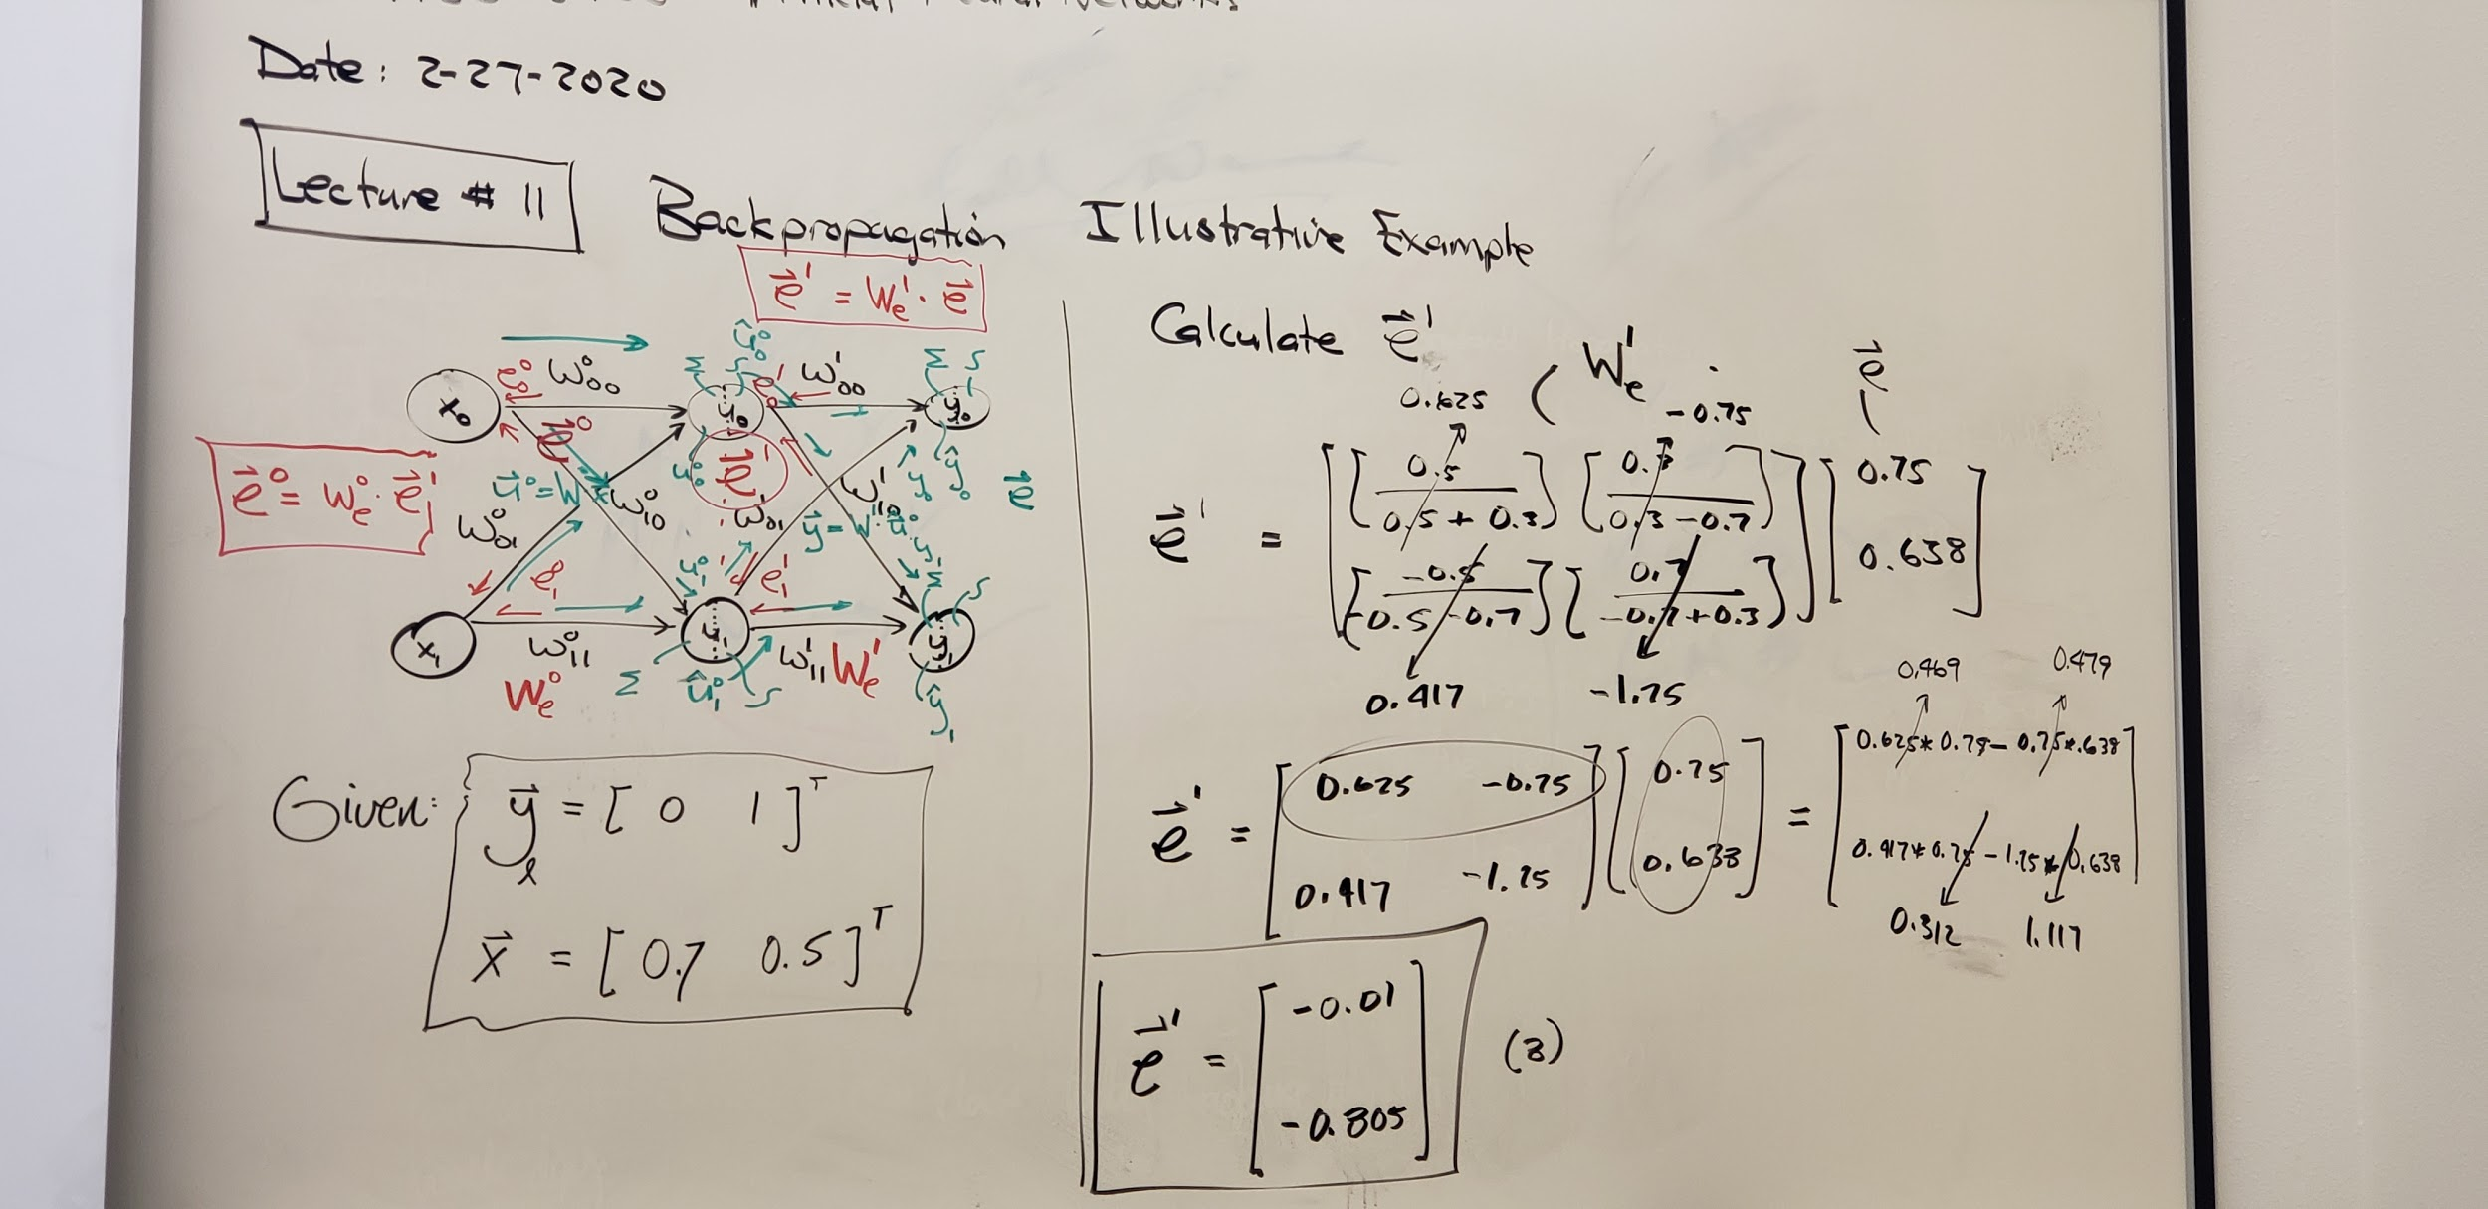

Slide 54
LECTURE #13
3-2-2020

Slide 55
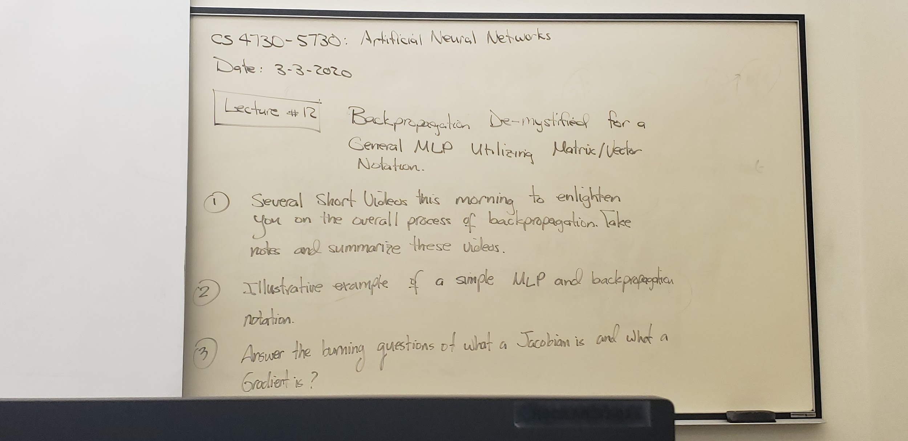

Slide 56
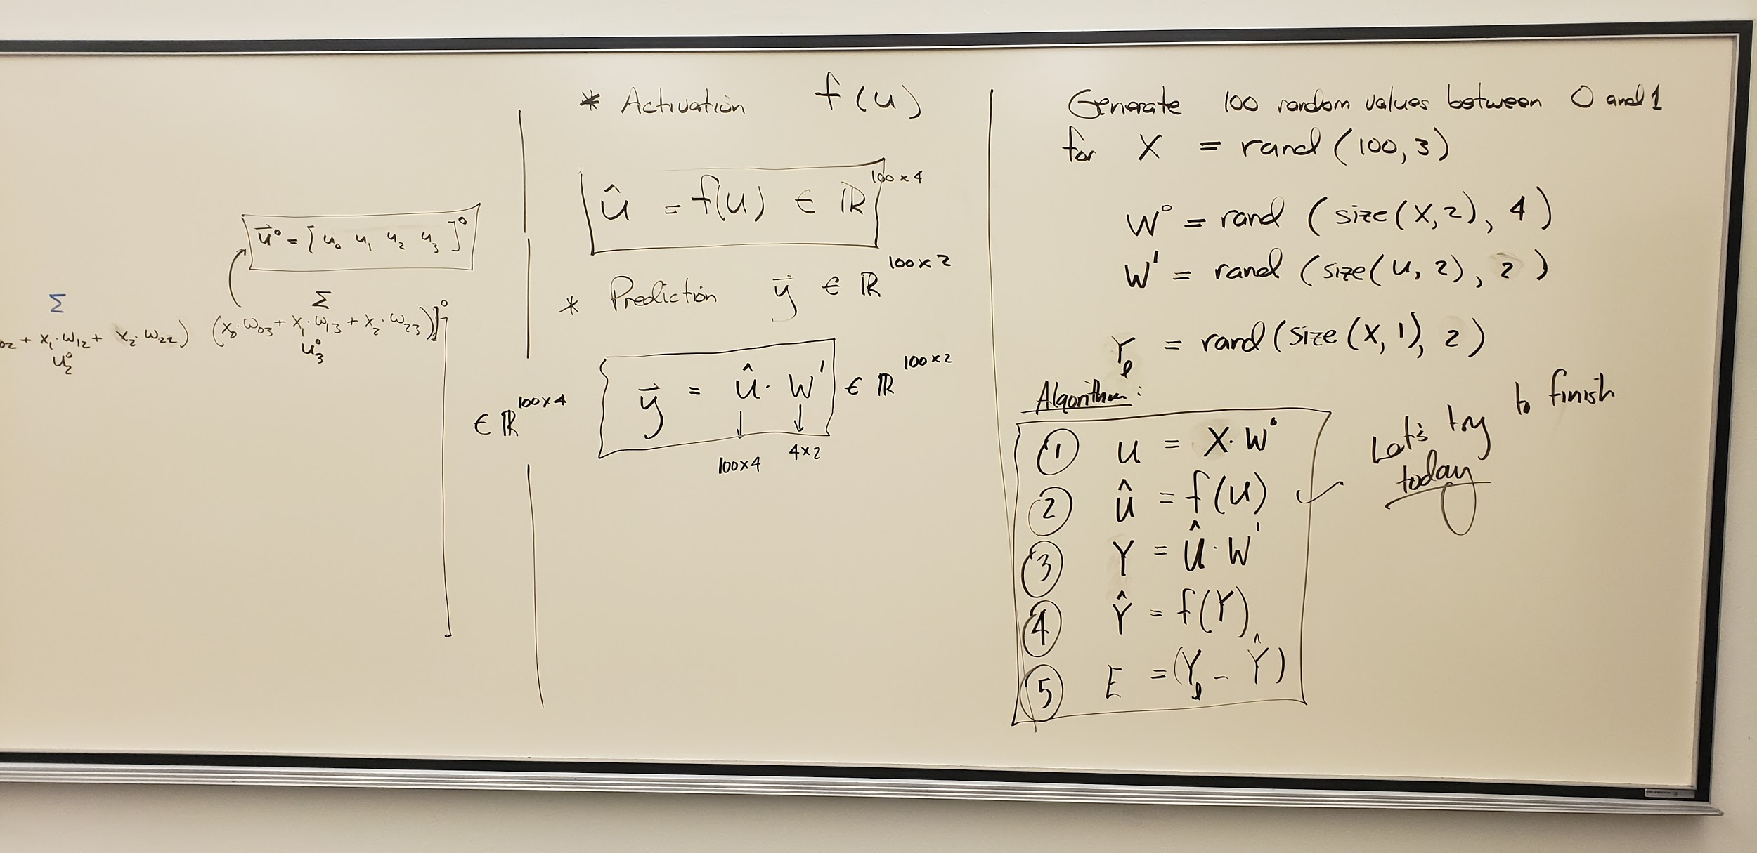
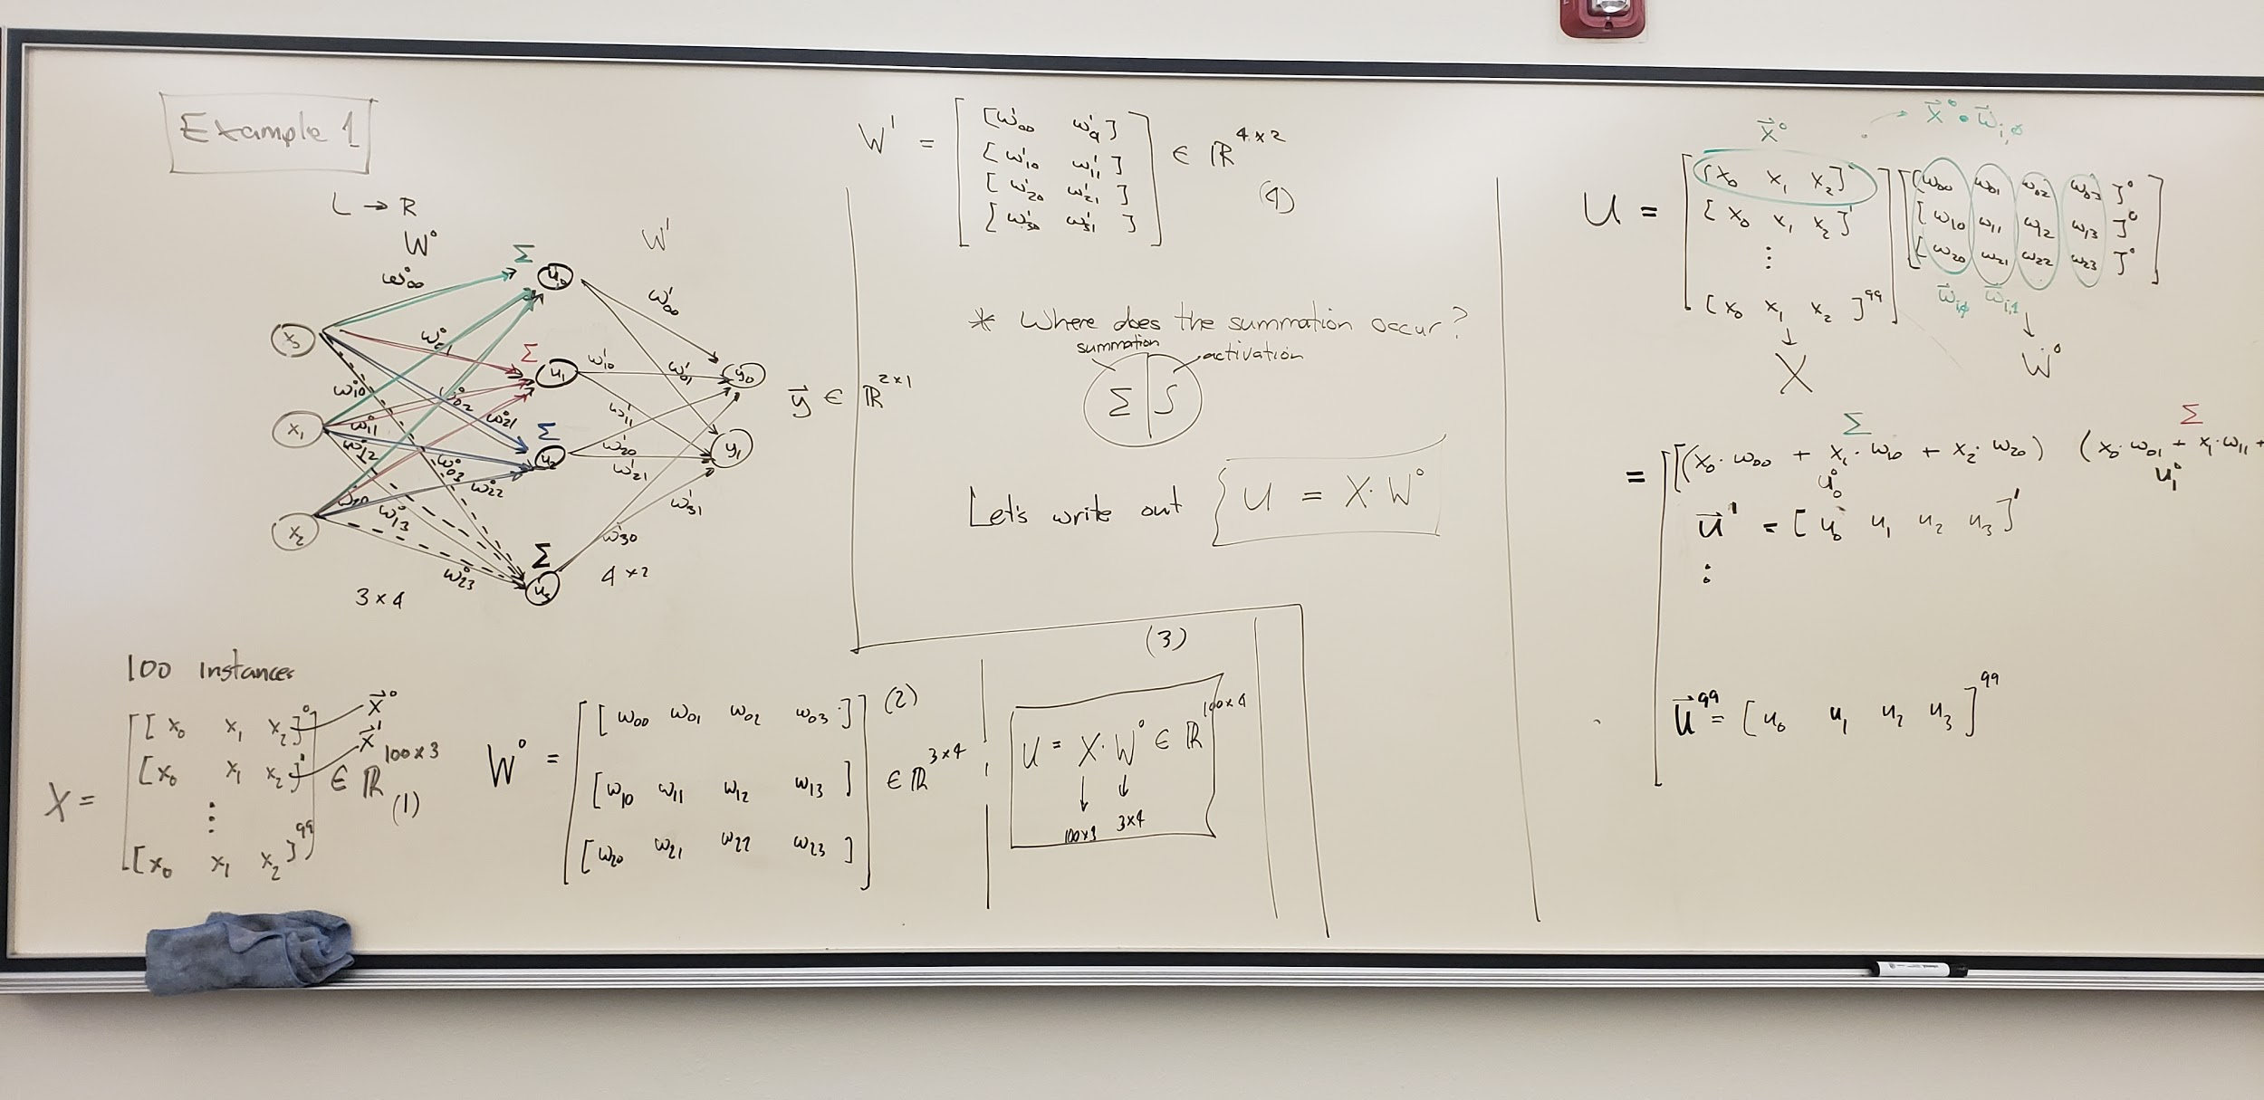

Slide 57
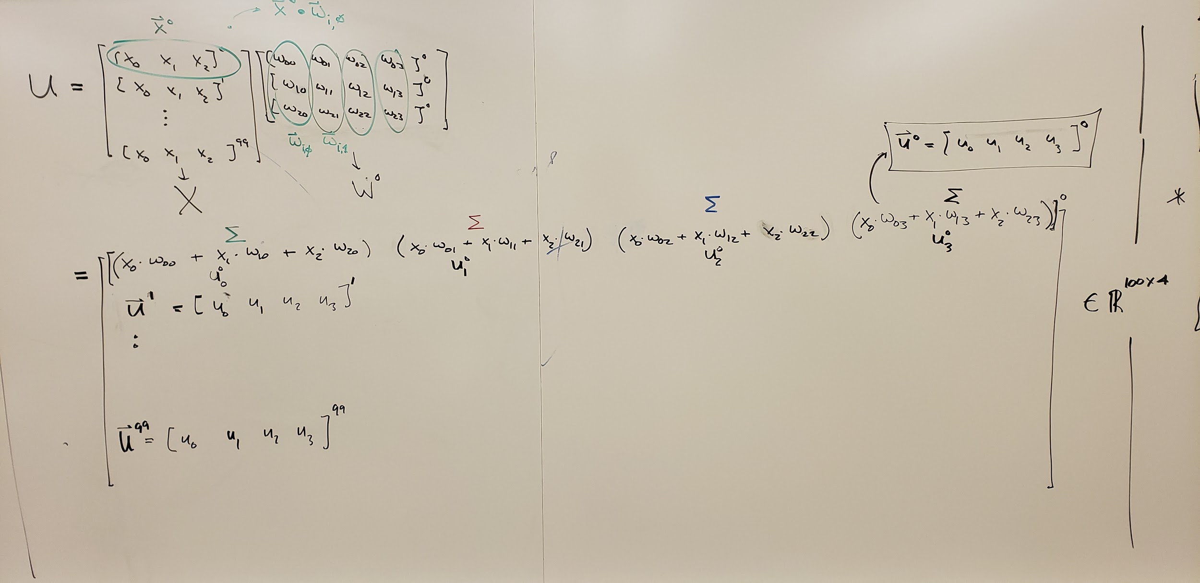

Slide 59
LECTURE #13
3-5-2020

Slide 60
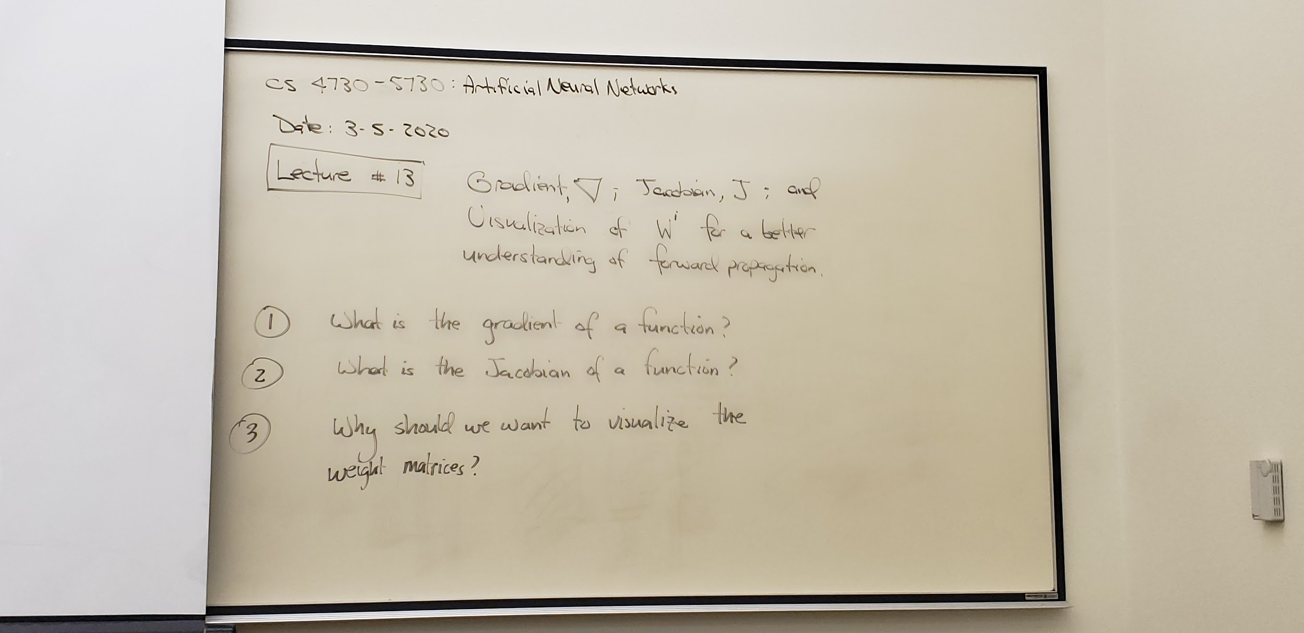

Slide 61


Slide 62


Slide 63


Slide 64


Slide 65


Slide 66

subplot(2,1,1);
imshow(f_hat_h);
subplot(2,1,2);
imshow(f_hat_v)
figure;

Slide 67
LECTURE #14
3-12-2020

Slide 68


Slide 69


Slide 70


Slide 71


Slide 72


Slide 73
April 2, 2020
https://www.youtube.com/watch?v=IHZwWFHWa-w&t=313s https://www.youtube.com/watch?v=gZmobeGL0Yg&list=PLZbbT5o_s2xq7LwI2y8_QtvuXZedL6tQU&index=1
https://arxiv.org/pdf/1611.03530.pdf
https://www.researchgate.net/publication/269040844_The_Loss_Surface_of_Multilayer_Networks

Slide 74
April 7th 2020
Today’s links
https://web.stanford.edu/class/cs224n/readings/gradient-notes.pdf
https://www.youtube.com/watch?v=1JbfCFMX7os
Hopefully a helpful extra https://www.onlinemathlearning.com/matrices-types.html

